Slide 1





Language Extensibility,
Metaprogramming and
Proof automation
Meta-F*
Jonathan Protzenko
MSR Redmond
As applied in Project Everest
https://fstar-lang.github.io
https://project-everest.github.io/

Slide 2
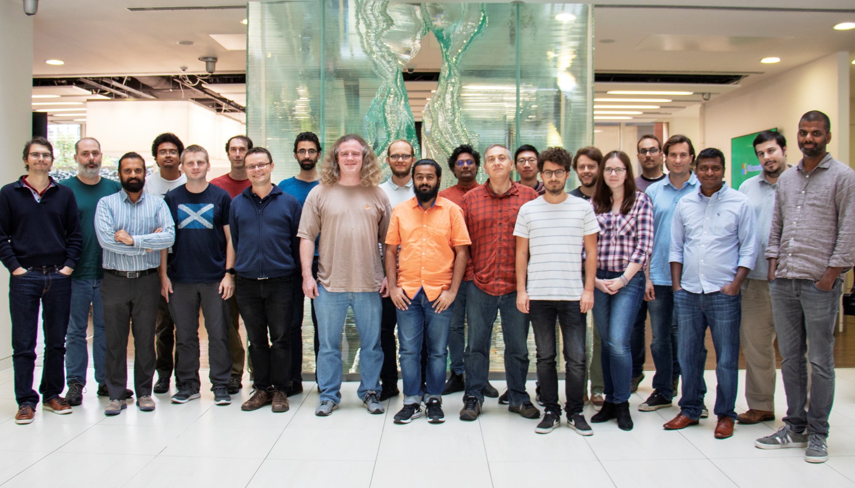
MSR Redmond
  Barry Bond
  Chris Hawblitzel
  Qunyan Magnus
  Kiran Muthabatulla
  Jonathan Protzenko
  Tahina Ramananandro
  Nikhil Swamy
  Gustavo Varo
MSR Cambridge
  Antoine Delignat-Lavaud
  Cédric Fournet
  Christoph M. Wintersteiger
  Santiago Zanella-Béguelin
MSR India
  Aseem Rastogi
INRIA Paris
  Danel Ahman
  Kenji Maillard
  Benjamin Beurdouche
  Karthikeyan Bhargavan
  Victor Dumitrescu
  Cătălin Hriţcu
  Marina Polubelova
CMU (Pittsburgh)
  Jay Bosamiya
  Aymeric Fromherz
  Bryan Parno
Edinburgh
  Markulf Kohlweiss
Interns, open-source contributors, visitors, alumns
Guido Martinez
Zoe Paraskevopoulou
Yao Li
Joonwon Choi
Clément Pit-Claudel
Nick Giannarakis
Niklas Grimm
Anita Gollamudi
Nadim Kobeissi
Matteo Maffei
Asher Manning
Monal Narasimhamurthy
Gordon Plotkin
Perry Wang
Jean-Karim Zinzindohoue
2016 -- present

Slide 3
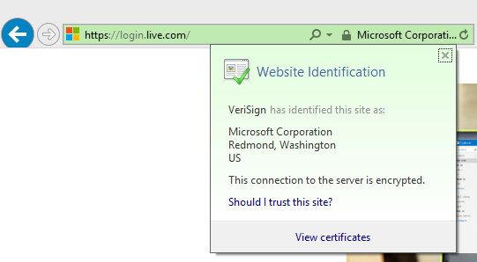
TLS: Transport Layer Security
Most widely deployed security?
½ Internet traffic (+40%/year)
Web, cloud, email, VoIP, 802.1x, VPNs, …
Notes:
The first research question is: how do we decide whether https:// is secure?
This is not part of the standards.
Especially when interoperating in a dangerous ecosystem.
We want to express clear, strong security guarantees at the HTTPS API (hiding all cryptographic details).

Slide 4

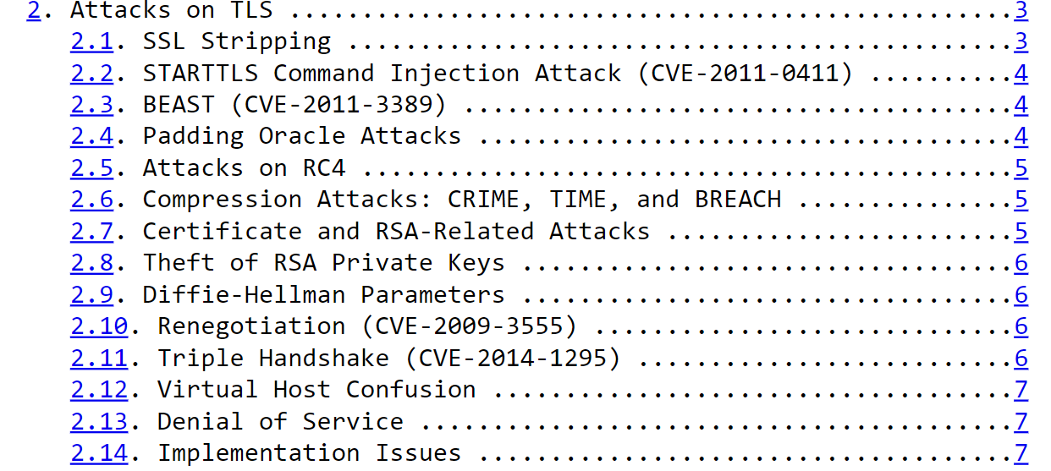
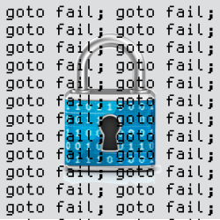


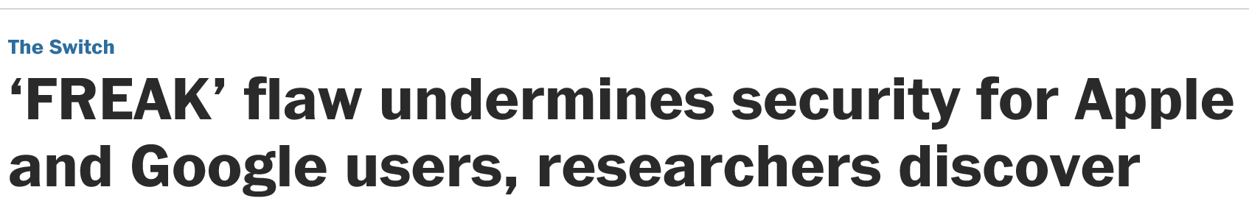
TLS: Transport Layer Security
Goal: A secure channel
20 years of attacks & fixes
Buffer overflows
Incorrect state machines
Lax certificate parsing
Weak or poorly implemented crypto
Side channels
Informal security goals
Dangerous APIs
Flawed standards
Mainstream implementations
OpenSSL, SChannel, NSS, …
Public Key
Infrastructure
client credential
server credential
connect(server,port);
send “GET…”;
data = recv();
send “POST…”;
…
accept(port);
request = recv();
send “<html>…”;
order = recv();
…
client
server
adversary
Threat model: Adversary fully controls the network, e.g.
it can redirect traffic to its own server (DNS rebinding)
it can passively read all data (IP monitoring)
it can play an active man-in-the-middle (TCP hijacking)
As long as the adversary does not control
the long-term credentials of the client and server, it cannot
Inject forged data into the stream (authenticity)
Distinguish the data stream from random bytes (confidentiality)
Notes:
The first research question is: how do we decide whether https:// is secure?
This is not part of the standards.
Especially when interoperating in a dangerous ecosystem.
We want to express clear, strong security guarantees at the HTTPS API (hiding all cryptographic details).

Slide 5
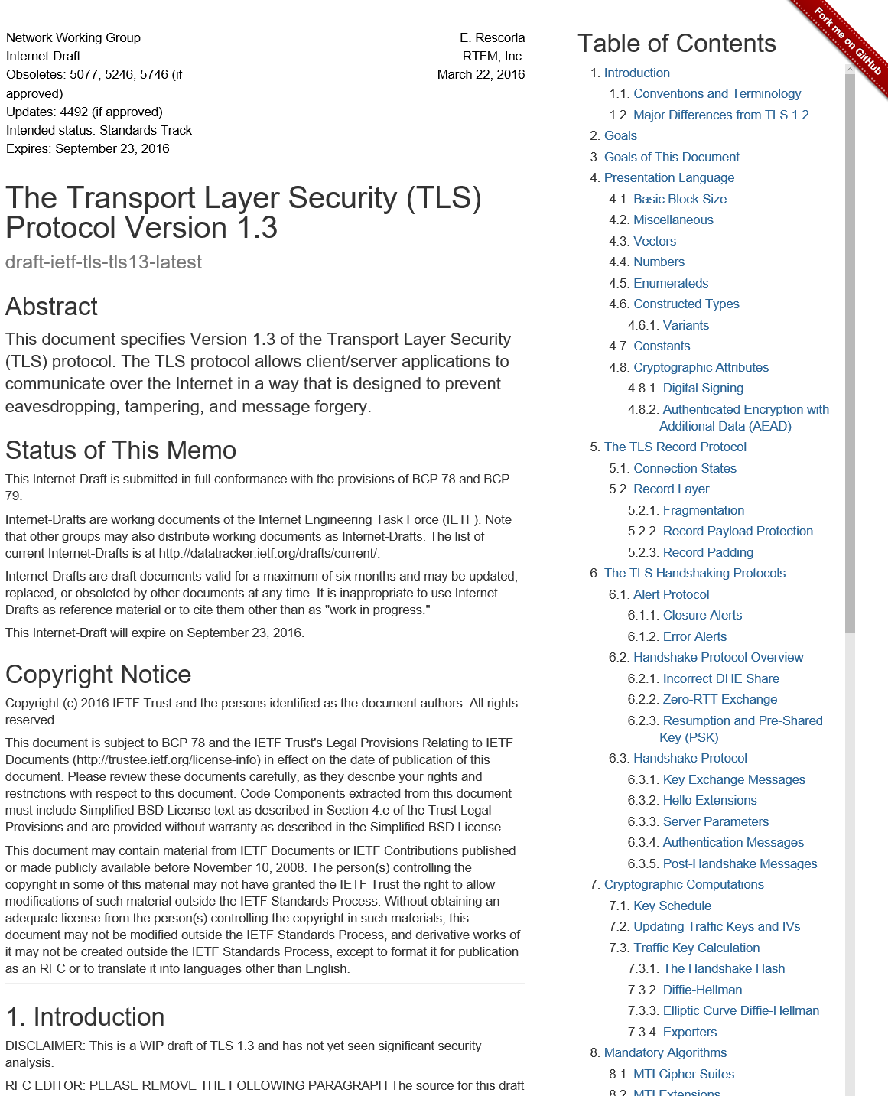
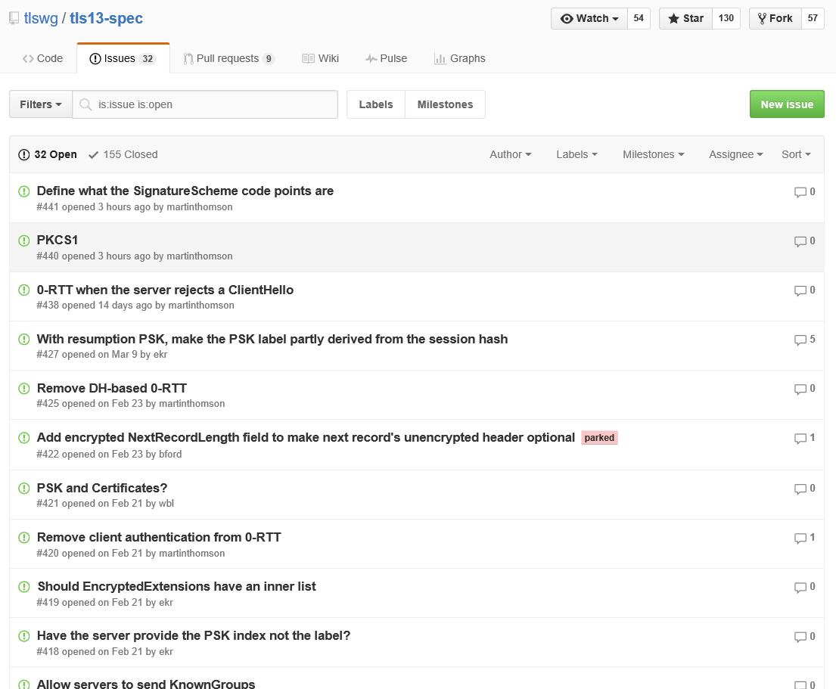
TLS 1.3: a new hope
Much discussions
  IETF, Google, Mozilla, Microsoft, CDNs,
  cryptographers, network engineers, …
Much improvements
  Modern design
  Fewer roundtrips
  Stronger security
New implementations
required for all
  An early implementer and verified too!
  Find & fix flaws before it’s too late
RFC 8446: Aug 2018
Including many of our proposals
  #4 log-based key separation
  extended session hashes
  (fixing attacks we found on 1.2)
  #11 stream terminators
  (eventually fixing an attack)
  #14 downgrade resilience
  #15 session ticket format
  #17 simplified key schedule
  pre-shared-key 0RTT
  #18 PSK binding (fixing an attack)
Mentioning many formal models of the protocol, including our verified implementation of the record layer
Notes:
IETF drafting the new standard.

Slide 6


Project Everest
Verified Secure Components
in the TLS Ecosystem
Strong verified security
Widespread deployment
Trustworthy, usable tools
Growing expertise in
high-assurance software
development
Open source
TLS
ECDH
AES
QUIC
RSA
SHA
…
Crypto Algorithms
Network buffers
Untrusted network (TCP, UDP, …)
Notes:
Fully-verified standards-compliant replacement
- We will prove cryptographic security, not just eliminate bugs.
- As a result, we rule out both past attacks, and attacks we haven’t even thought of yet
Many academically successful verification projects. Few deployments.

Slide 7
Verification Tools and Methodology
F*: A general purpose
programming language
and verification
tool
val poly1305_mac: tag:nbytes 16 →
len:u32 →
msg:nbytes len{disjoint tag msg} →
key:nbytes 32 {disjoint msg key ∧ disjoint tag key} →
ST unit
  (requires (λ h → msg ∈ h ∧ key ∈ h ∧ tag ∈ h))
  (ensures (λ h0 _ h1 →
  let r=Spec.clamp h0.[sub key 0 16] in
  let s=h0.[sub key 16 16] in
  modifies {tag} h0 h1 ∧
  h1.[tag] == Spec.mac_1305 (encode_bytes h0.[msg]) r s))
Math spec in F*
poly1305_mac computes a polynomial in GF(2¹³⁰-5),
storing the result in tag,
and not modifying anything else
kreMLin
void
poly1305_mac(uint8_t *tag, uint32_t len, uint8_t *msg, uint8_t *key)
{
uint64_t tmp [10] = { 0 };
uint64_t *acc = tmp
uint64_t *r = tmp + (uint32_t)5;
uint8_t s[16] = { 0 };
Crypto_Symmetric_Poly1305_poly1305_init(r, s, key);
Crypto_Symmetric_Poly1305_poly1305_process(msg, len, acc, r);
Crypto_Symmetric_Poly1305_poly1305_finish(tag, acc, s);
}
Compiler from
(a subset of)
F* to C
Efficient C implementation
Verification imposes no runtime performance overhead
C
Notes:
Long-term research effort, not specific to communications security.
By necessity we will improve our tools and their usability.
Automation is key (Z3)
Format a bit

Slide 8

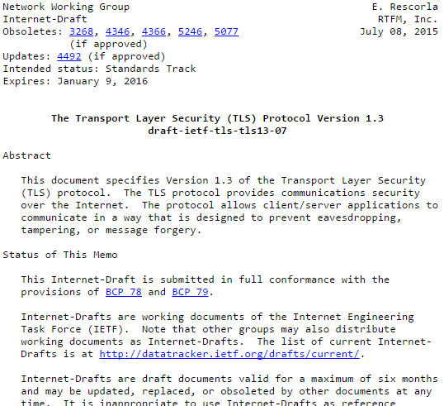
Proof strategy (simplified)
= Trusted
= Verified
Security spec
Secure authenticated channel
Protocol security proofs
Protocol specs
Implementation
AES is a pseudo-random function
Crypto assumptions

Slide 9
What do we verify?
Safety
  Memory- and type-safety. Mitigates buffer overruns, dangling pointers, code injections.
Functional correctness
  Our fast implementations behave precisely as our simpler specifications.
Secrecy
  Access to secrets, including crypto keys and private app data is restricted according to design.
Cryptographic security
  We bound the probability that an attacker may break any secrecy or integrity properties
Notes:
Secrecy includes side-channel resistance.
All of this applies to both code in F* and in Vale. We verify the assembly code follows the “rules of the road” for calling convention, as well as that no secrets are leaked on the stack or in any register (even x86 EFLAGS) when we return out of assembly code.

Slide 10



Everest in Action, so far
Production deployments of Everest Verified Cryptography
WinQUIC: Delivered Everest TLS 1.3 and crypto stack to Windows Networking, in the latest Windows developer previews
Mozilla NSS runs Everest verified crypto for several core algorithms
Everest verified crypto in the Linux kernel via WireGuard secure VPN
Notes:
Fully-verified standards-compliant replacement
- We will prove cryptographic security, not just eliminate bugs.
- As a result, we rule out both past attacks, and attacks we haven’t even thought of yet
Many academically successful verification projects. Few deployments.

Slide 11
Project Everest
Verified Secure Components
in the TLS Ecosystem
Strong verified security
Widespread deployment
Trustworthy, usable tools
Growing expertise in
high-assurance software
development
Open source
TLS
ECDH
AES
QUIC
RSA
SHA
…
Crypto Algorithms
Network buffers
Untrusted network (TCP, UDP, …)
Notes:
Fully-verified standards-compliant replacement
- We will prove cryptographic security, not just eliminate bugs.
- As a result, we rule out both past attacks, and attacks we haven’t even thought of yet
Many academically successful verification projects. Few deployments.

Slide 12
So what is this F* thing anyway?
A programming language
A proof assistant
A program verification tool

Slide 13
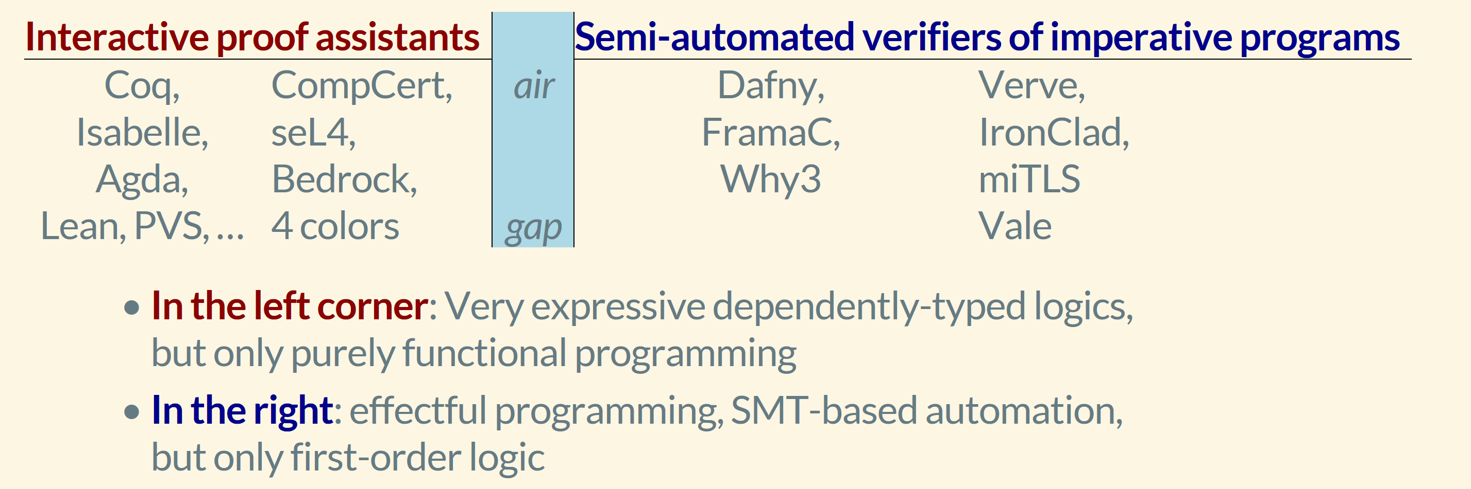
Two camps of program verification tools

Slide 14
F*: Bridging the gap
Functional programming language with effects
  Like OCaml, Haskell, F#, …
  Compiles to OCaml or F#
  A subset of F* compiled to C (with manual control over memory management)
With an expressive core dependent type theory
  Like Coq, Agda, Lean, …
Semi-automated verification using SMT
  Like Dafny, Vcc, Liquid Haskell, …
In-language extensibility and proof automation using metaprograms

Slide 15
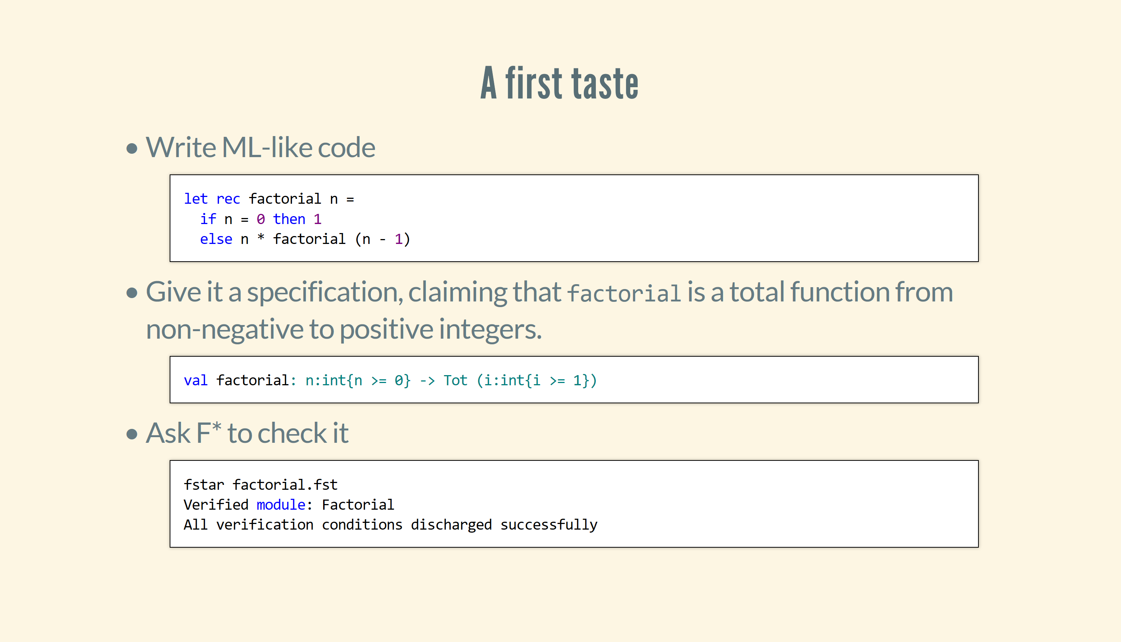

Slide 16
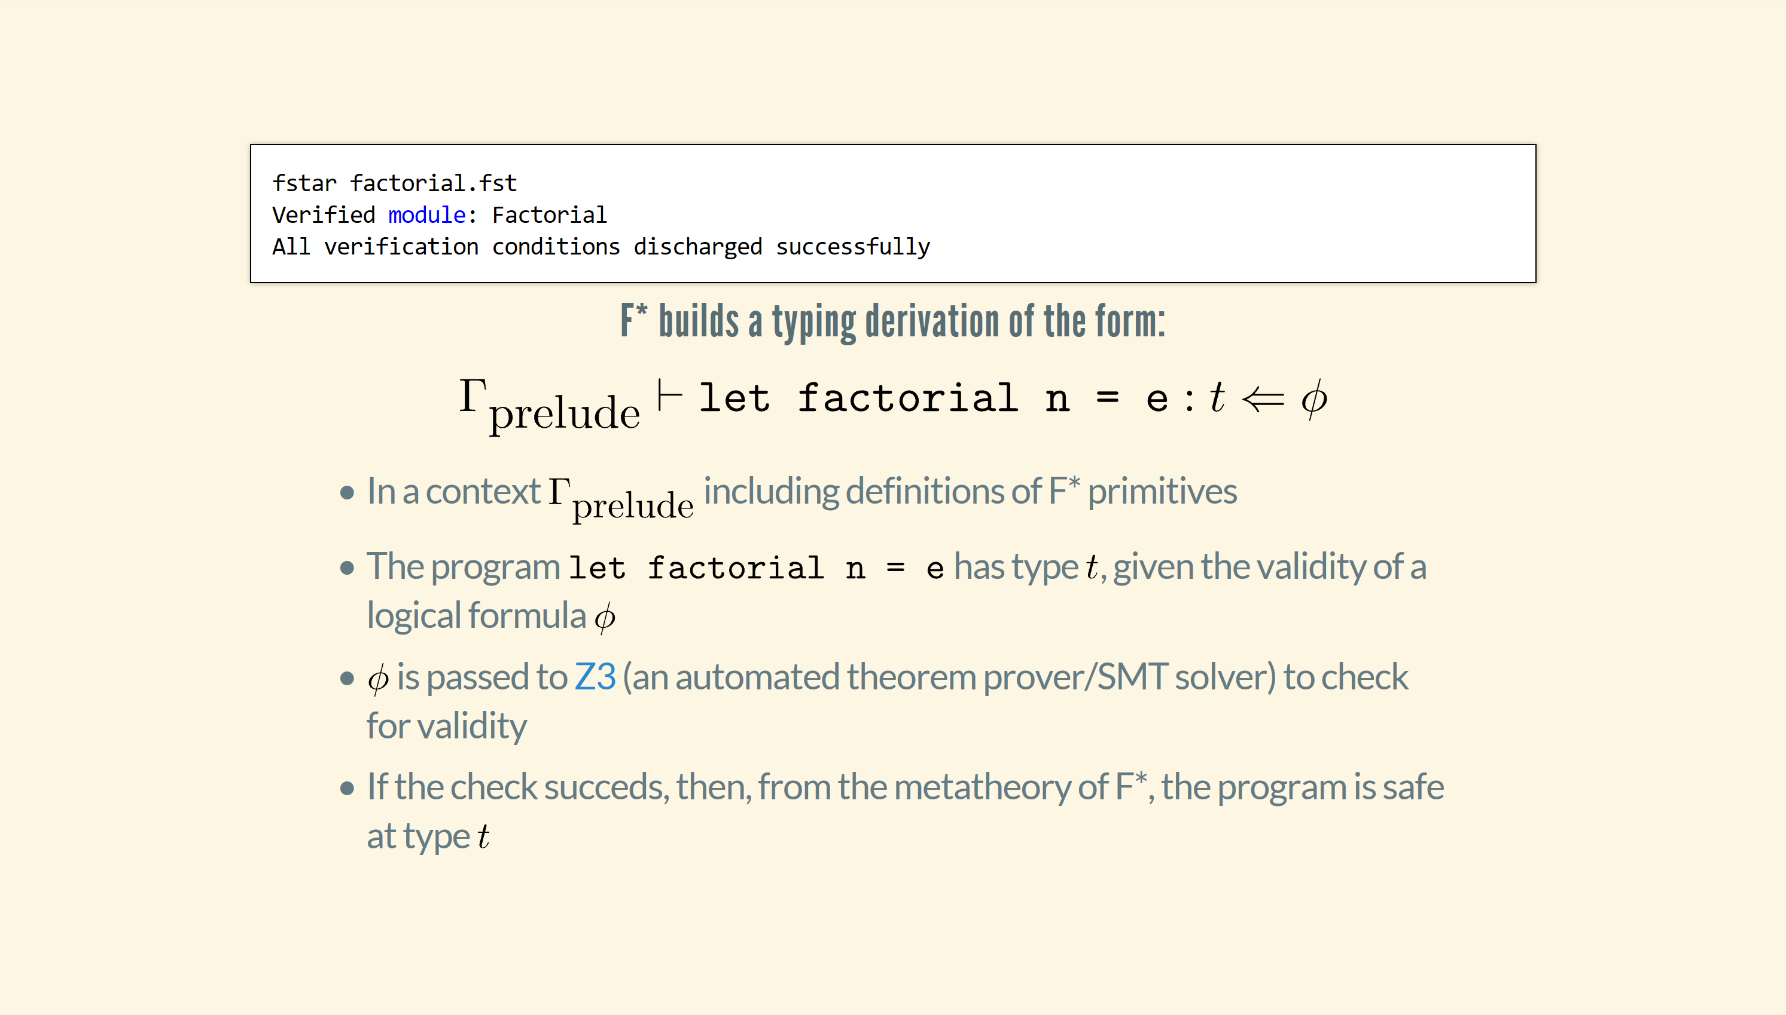

Slide 17
Beyond Pure Code
Effects
Programmers model effects with monads
  st a = s -> a * s
F* derives a WP calculus for use with that monad
  Also known as Dijkstra monads
  st_post a = a * s -> prop
  st_pre = s -> prop
  wp_st a = st_post a -> st_pre
Along with a computation type for effectful terms
  Computations indexed by their own WPs: STATE a (wp : wp_st a)

Slide 18
Beyond Pure Code
Effects (2)
Reify allows the programmer to view an effectful term as a pure, state-passing style term
  extrinsic proofs for effectful terms
  captures the operational behavior of effectful terms
  hence allows running them (more on that later)
Reflect is the converse
  not all effects are reflectable (breaks abstraction)

Slide 19
Effectful programs with Hoare-style Specifications
let invert (r:ref int)
: STExn unit
(requires fun h0 -> True)
(ensures fun h0 v h1 -> no_exn v ==> h0.[r] <> 0 /\ h1.[r] = 1 / h0.[r])
=
let x = !r in
if x = 0 then
raise Division_by_zero
else r := 1 / x

Slide 20
Effectful programs with Hoare-style Specifications
let invert (r:ref int)
: STExn unit
(requires fun h0 -> h0.[r] <> 0)
(ensures fun h0 v h1 -> no_exn v /\ h1.[r] = 1 / h0.[r])
=
let x = !r in
if x = 0 then
raise Division_by_zero
else r := 1 / x

Slide 21
Exploiting Expressiveness & Extensibility
Low*: A subset of F* that compiles to C
Embed within F* a CompCert C-like memory model
  Low*: An effect for stateful programs manipulating a C-like memory model
  Programs in the Low* effect are extracted to C by KreMLin, F*’s C backend
Separate memory region for heaps and stacks
  A region is a heterogeneous partial map
  region = addr -> option (a:Type & a)
With libraries modeling mutable arrays, pointers, structs, unions

Slide 22
Low* to C
And to support compilation to C, in nearly 1-1 correspondence, for auditability of our generated code
Designed to allow manipulating a C-like view of memory
Low*
C
COMPILED
Erased
specification
Stack allocation
Pointer arithmetic

Slide 23
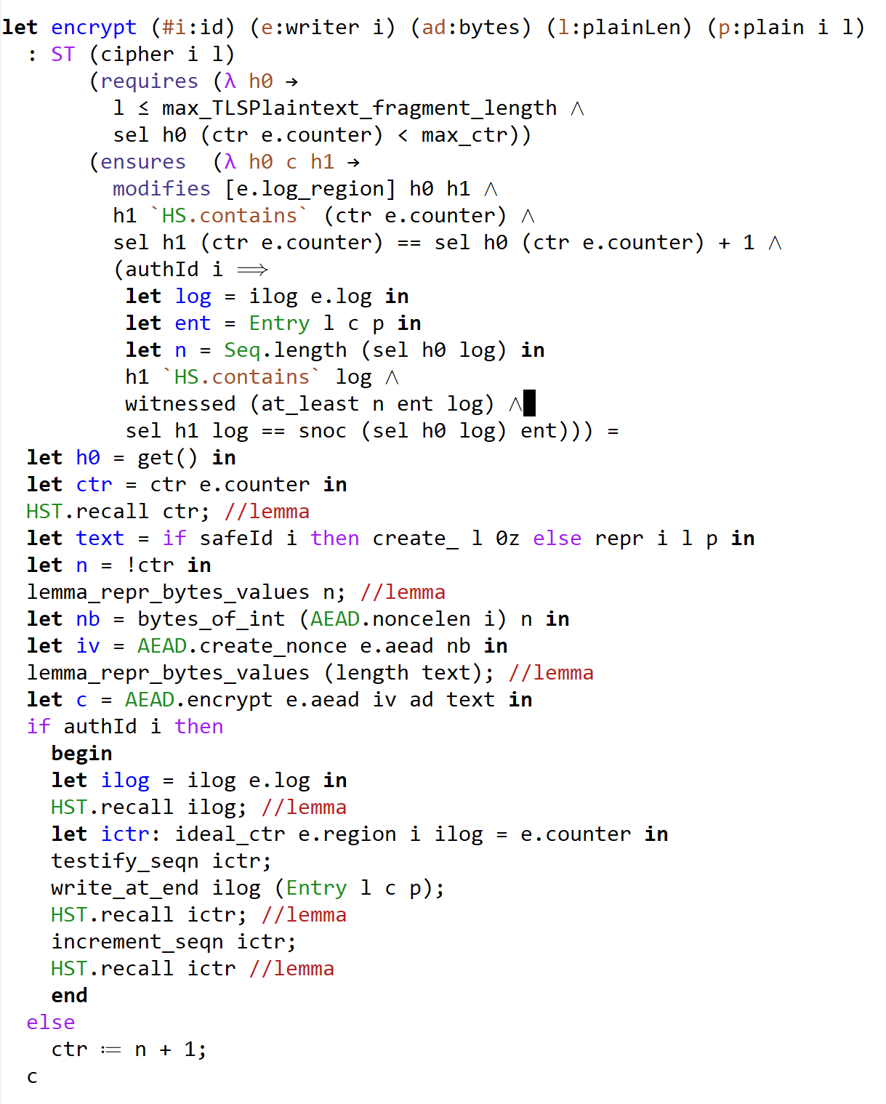
Dependently typed specs in the style of Hoare Type Theory / Coq
Dafny-ish proofs mostly automated by SMT, with a few well-chosen user-supplied lemmas

Slide 24
But SMT-based proofs can go awry
E.g., when using theories like non-linear arithmetic
Forced to write very detailed proof terms when SMT fails

Slide 25
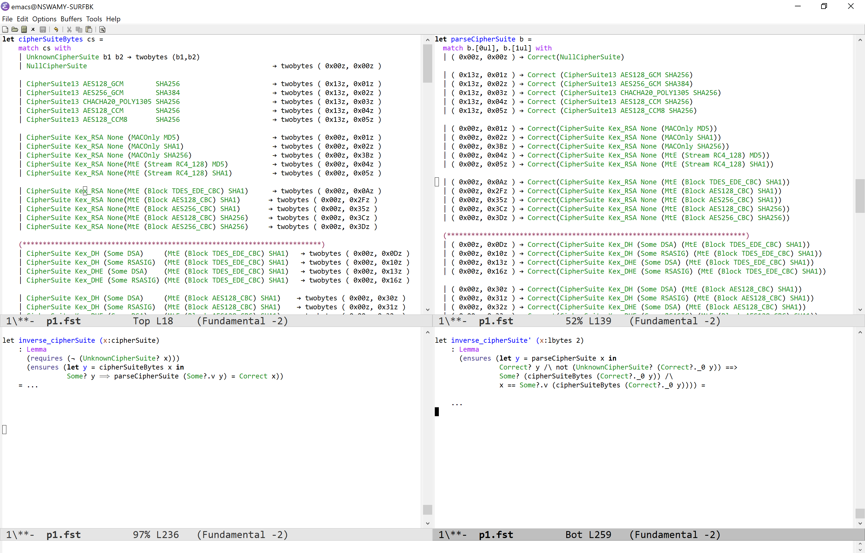
And can be at a low level of abstraction
Lots of boilerplate to define parsers/formatters and prove them mutually inverse

Slide 26
Domain-specific languages, ad hoc proof automation, extensibility
Allow programmers to:
Customize how programs are typechecked, producing domain-specific VCs
Metaprogram programs and their proofs
Define their own equivalence preserving program transformations
…

Slide 27
Domain-specific languages, ad hoc proof automation, extensibility
By treating the F* object language as its own metalanguage
Building on elaborator reflection a great idea by
David Christiansen and Edwin Brady (Idris)
Leonardo de Moura (Lean)

Slide 28
A passive compiler pipeline
Program.fst
Parsing & Desugaring
Typechecker
Extraction aka
Code generation
Higher-order Unification
Normalizer
SMT Encoding
Program.ml

Slide 29
Scripting components with a metaprogram
Program.fst
Parsing & Desugaring
Typechecker
Extraction aka
Code generation
Higher-order Unification
Normalizer
SMT Encoding
Program.ml
MetaProgram.fst

Slide 30
Scripting a language implementation from within the language
Provide a API to compiler internals for F* (meta)programs to reflect and/or construct
Syntax of terms
Typechecking environment
Typing derivations
…
F* compiler runs F* metaprograms to build and typecheck other F* programs

Slide 31
From F* to Meta-F*,
In three easy steps
Metaprogramming as a computational effect of proof-state transformers
Primitive operations to manipulate proof-states, using trusted compiler primitives
Reflecting on syntax: quotation and unquotation

Slide 32
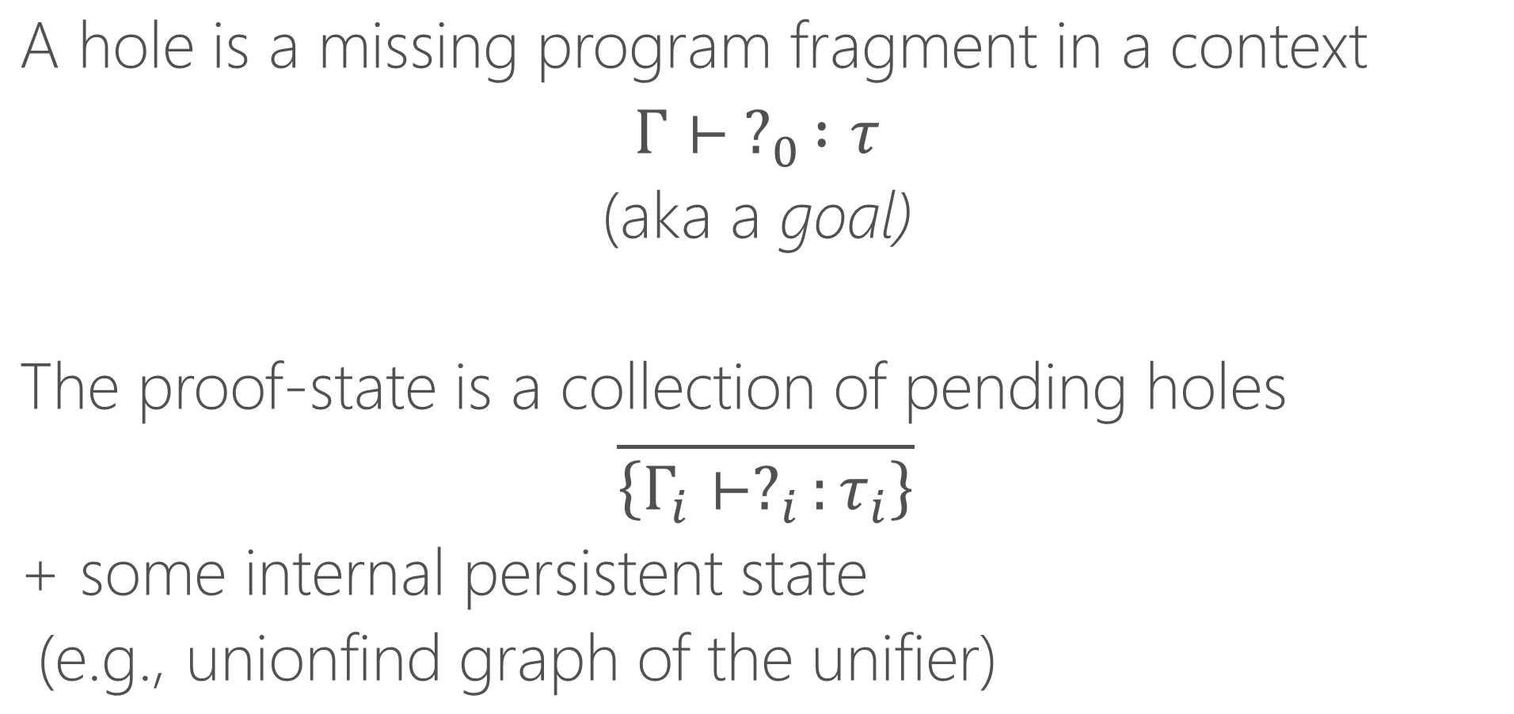
Proof-state: A collection of typed holes
A hole is a missing program fragment in a context
$Γ⊢ ?_{0} :τ$
(aka a goal)
The proof-state is a collection of pending holes
$\overline{\left\{Γ_{i}⊢?_{i}:τ_{i}\right\}}$
+ some internal persistent state
(e.g., unionfind graph of the unifier)

Slide 33
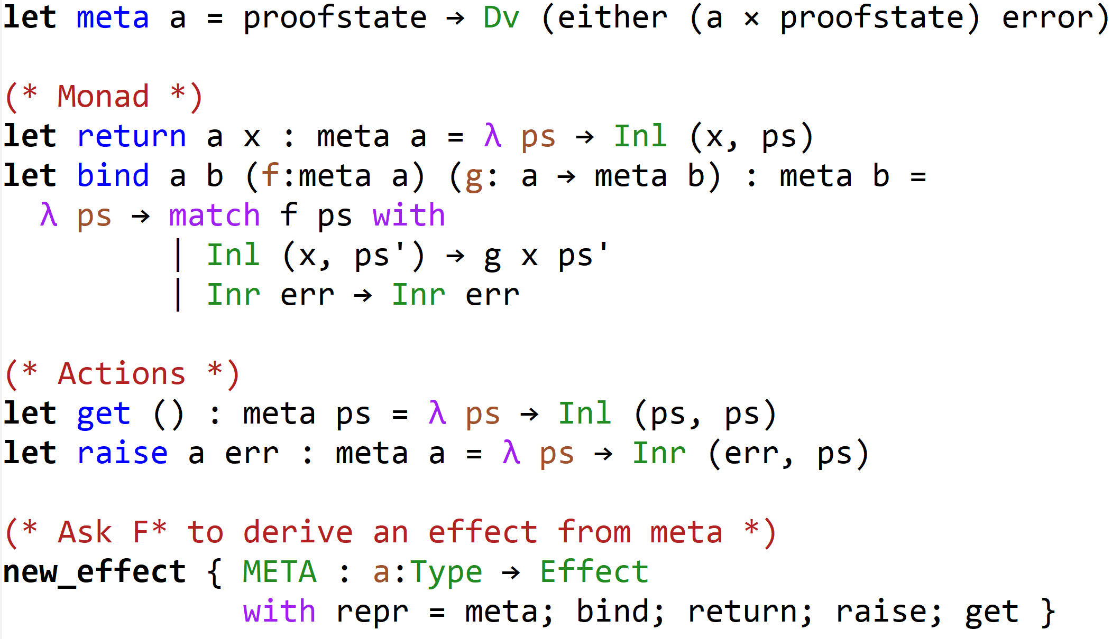
Metaprograms are proofstate transformers
Uses an existing F* effect for non-termination: Dv
The type of the state is an abstract type: proofstate
error is the type of exceptions
State + Exception + Non-termination monad

Slide 34
Metaprogramming as a user-defined effect
Standard definitions of return, bind, get, raise
Exceptions reset the state

Slide 35
Metaprogramming as a user-defined effect
Conspicuously, no put action
The proofstate is a compiler internal data structure.
A metaprogram can read it but cannot modify it arbitrarily

Slide 36
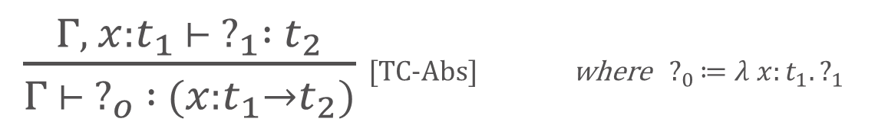
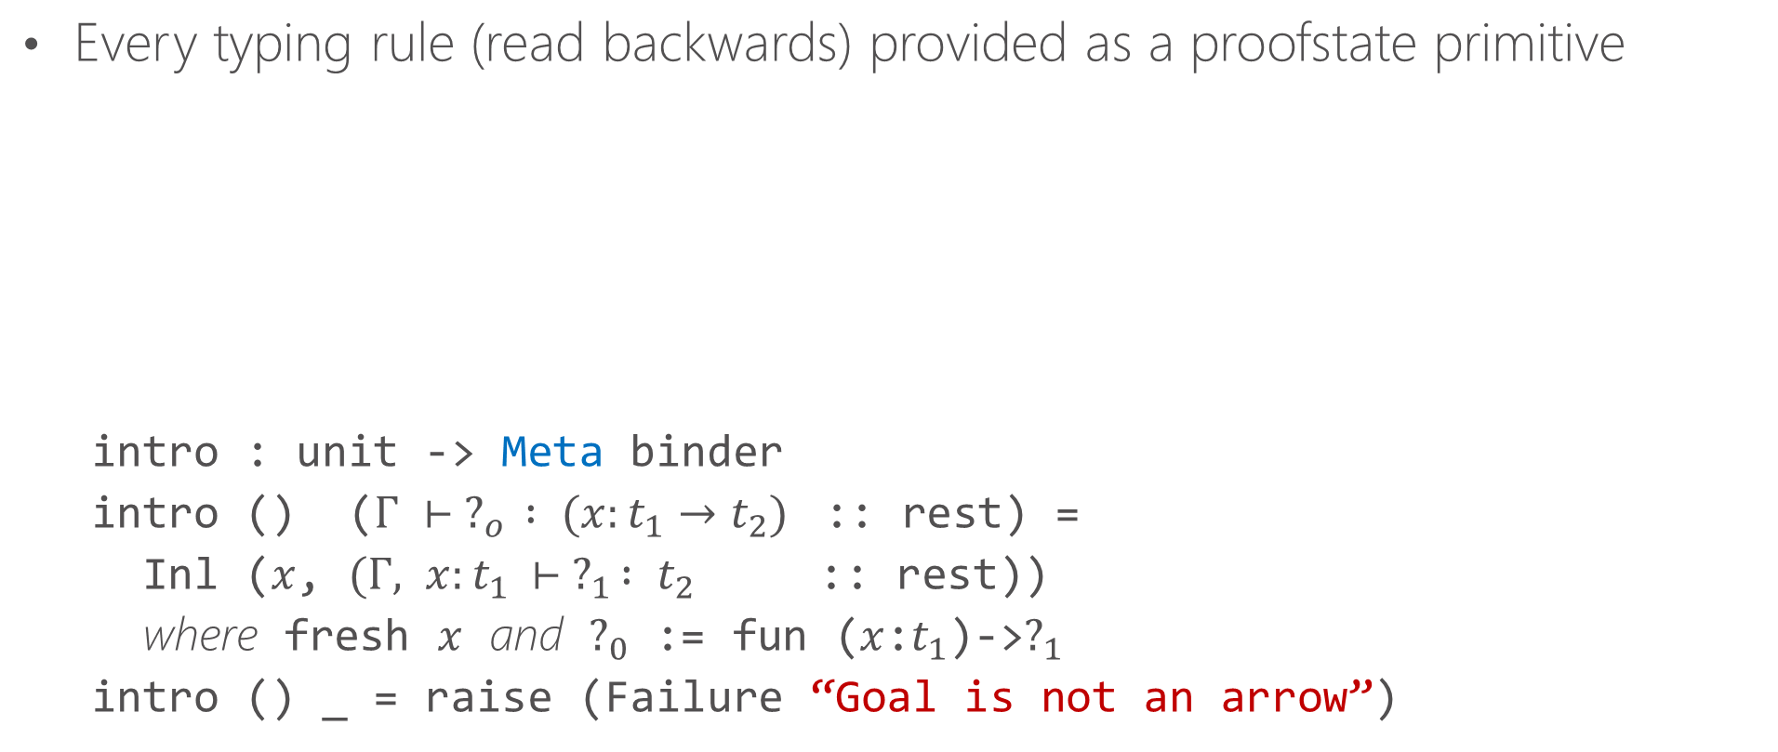
Step 2
Primitive operations on proofstate
Every typing rule (read backwards) provided as a proofstate primitive
    intro : unit -> Meta binder
    intro () ($Γ ⊢ ?_{o} : (x:t_{1}→t_{2})$ :: rest) =
    Inl ($x$, $(Γ, x:t_{1 }⊢ ?_{1} : t_{2}$ :: rest))
    where fresh $x$ and $?_{0}$ := fun ($x$:$t_{1}$)->$?_{1}$
    intro () _ = raise (Failure “Goal is not an arrow”)
$\frac{Γ, x:t_{1 }⊢ ?_{1} : t_{2}}{Γ ⊢ ?_{o} : (x:t_{1}→t_{2})}$[TC-Abs] where $?_{0}≔λ x:t_{1}. ?_{1}$

Slide 37
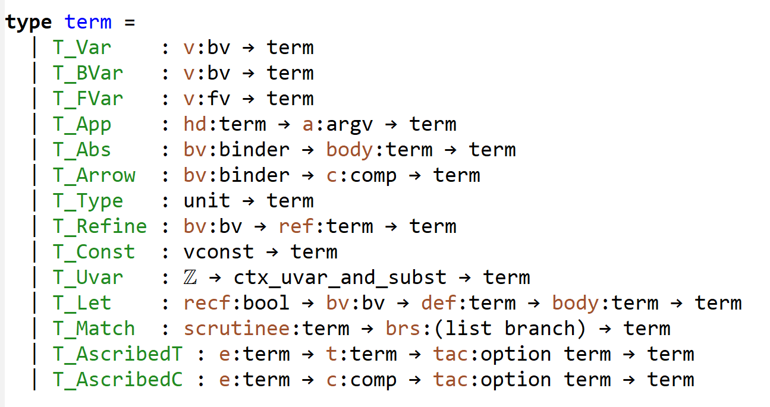
Step 3
Reflecting on syntax
Locally nameless abstract syntax of F* terms provided as a datatype to metaprograms
Quotation: Builds the syntax of a term
  `(0 + 1) : term
Unquotation
  Typechecks syntax at a given type
val unquote: a:Type -> x:term -> Meta a

Slide 38
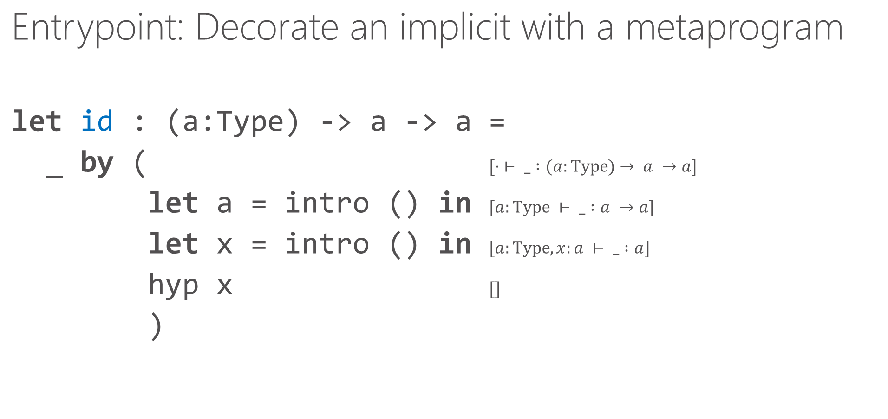
Putting it together
Entrypoint: Decorate an implicit with a metaprogram
let id : (a:Type) -> a -> a =
_ by ( $[⋅ ⊢ _ :(a:Type)→ a →a]$
let a = intro () in $[a:Type ⊢ _ :a →a]$
let x = intro () in $[a:Type, x:a ⊢ _ :a]$
hyp x $[]$
)

Slide 39
And can be at a low level of abstraction
Lots of boilerplate to define parsers/formatters and prove them mutually inverse
Remember this?

Slide 40
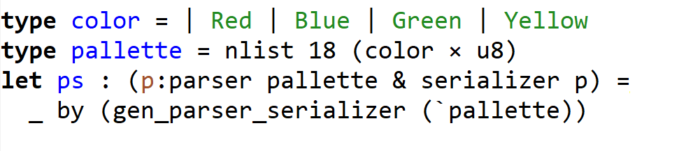
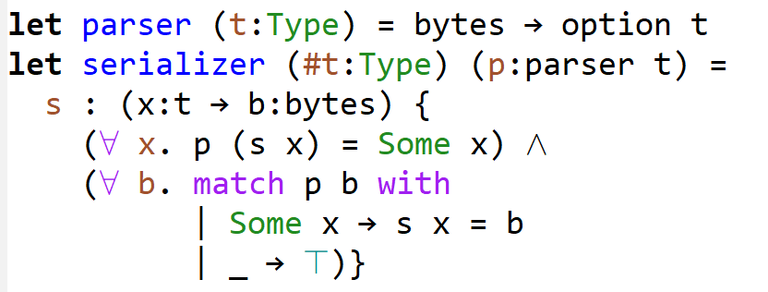
Metaprogramming mutually inverse parsers and formatters
Where, the types capture that parser/serializer are mutual inverses

Slide 41
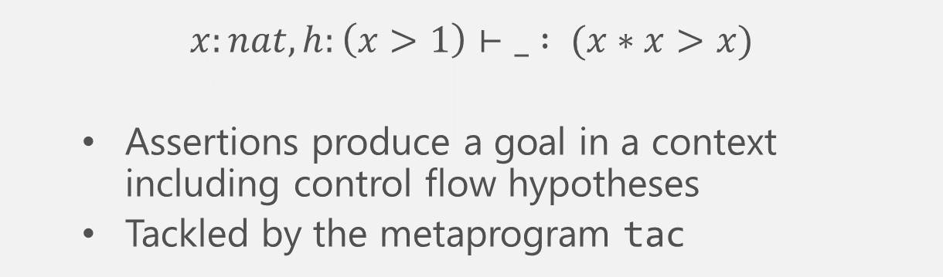
Putting it together
Entrypoint: Decorate an assertion with a metaprogram
let f (x:nat) =
if x > 1 then
assert (x * x > x)
by tac;
…
$$x:nat, h:\left(x>1\right)⊢_ : (x∗x>x)$$
  Assertions produce a goal in a context including control flow hypotheses
  Tackled by the metaprogram tac

Slide 42

SMT: Just one of F*’s tactic primitives
val smt: unit -> Meta unit
let f (x:nat) =
if x > 1 then
assert (x * x > x)
by (smt());
…
$$x:nat, h:\left(x>1\right)⊢_ : (x∗x>x)$$
  Assertions produce a goal in a context including control flow hypotheses
  Tackled by the metaprogram tac

Slide 43
But SMT-based proofs can go awry
E.g., when using theories like non-linear arithmetic
Remember this?
Forced to write very detailed proof terms when SMT fails

Slide 44
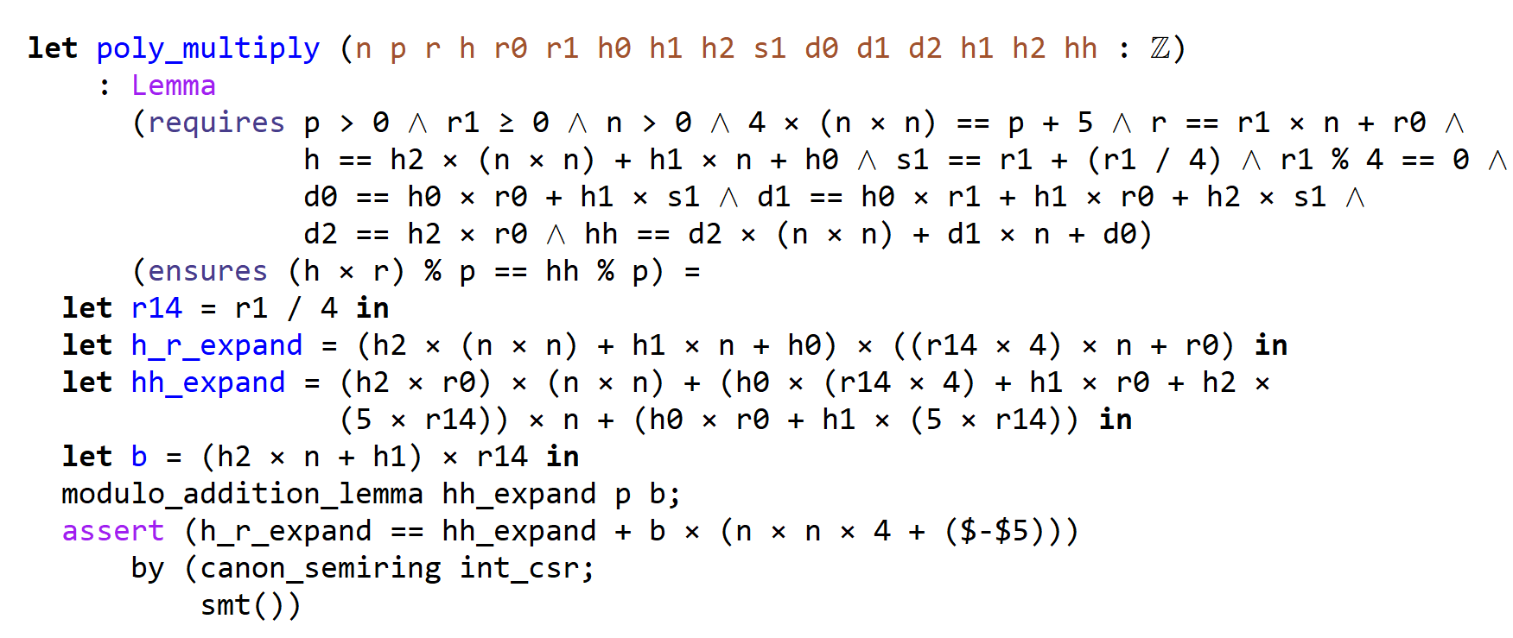
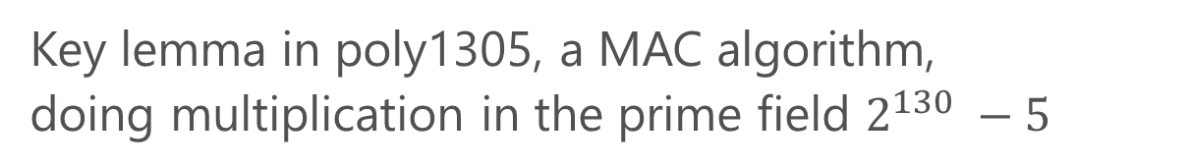
SMT + Tactics for more automated, robust proofs
Key lemma in poly1305, a MAC algorithm,
doing multiplication in the prime field $2^{130} −5$
A reflective metaprogram to canonicalize terms in commutative semirings
Simplifies goal into a form that smt can then solve using linear arithmetic only
Prior manual proof required 41 steps of explicit rewriting lemmas (!)

Slide 45
Partial evaluation for Low* productivity
This is not Low*:
Reason:
val compress:
a:sha_alg -> state a -> array u8 -> Stack unit
let state a = function
| SHA2_224 | SHA2_256 -> array u32
| SHA2_384 | SHA2_512 -> array u64
This could be compiled as a union. However, this is not idiomatic.
Instead, we rely on partial evaluation:
let compress_224 =
FStar.Tactics.(synth_by_tactic (specialize (compress SHA2_224)
[`% ... ]))
let compress_256 =
FStar.Tactics.(synth_by_tactic (specialize (compress SHA2_256)
[`% ... ]))
let compress_384 =
FStar.Tactics.(synth_by_tactic (specialize (compress SHA2_384)
[`% ... ]))
let compress_512 =
FStar.Tactics.(synth_by_tactic (specialize (compress SHA2_512)
[`% ... ]))

Slide 46
Higher-order combinators
It is frequent to combine core operations to generate a construction (counter-mode, hash, etc.)
Example:
Given any (abstract) compression function, one can define a Merkle-Damgård construction
Construction: folding the core compression function over multiple blocks of input data
We do not want to write this n times...

Slide 47
An example of a higher-order combinator
// Write once; this is not Low*
noextract inline_for_extraction
let mk_compress_blocks (a: hash_alg)
(compress: compress_st a)
(s: state a)
(input: blocks)
(n: u32 { length input = block_size a * n })
=
C.Loops.for 0ul n (fun i ->
compress s (Buffer.sub input (i * block_size a) (block_size a)))
// Specialize many times; now this is Low*
let compress_blocks_224 = FStar.Tactics.(synth_by_tactic (specialize SHA2_224) [`%...])
...
let compress_md5 = FStar.Tactics.(synth_by_tactic (specialize MD5) [`%...])
...

Slide 48
Meta-programming is pervasive
We use it for a given algorithm (SHA2)
We use it for constructions (Merkle-Damgard)
We will reuse combinators later on at the level of EverCrypt
More higher-order combinators, e.g.
noextract inline_for_extraction
let mk_hash (a: hash_alg)
(init: init_st a)
(compress_blocks: compress_blocks_st a)
(compress_last: compress_last_st a)
(extract: extract_st a)
=
...

Slide 49
Language extensions / DSLs in userland
Typeclass resolution as a user-provided program
  a hook to synthesize a term if F* fails to infer an implicit argument
  dedicated syntactic sugar
  optional arguments
Syntax for base64 array literals
  encoded via a string
  rewritten via a tactic into a suitable Low* array declaration
Deriving
  printers, marshalling functions, etc.
More
  tactics as an F* frontend for DSLs

Slide 50
Beyond Pure Code
Effects (2)
Reify allows the programmer to view an effectful term as a pure, state-passing style term
  extrinsic proofs for effectful terms
  captures the operational behavior of effectful terms
  hence allows running them (more on that later)
Reflect is the converse
  not all effects are reflectable (breaks abstraction)
Remember this?

Slide 51
Executing tactics
Tactics can be reified as proof-state-passing programs
F* features a normalizer (for higher-order unification)
Upon seeing a tactic, the F* type-checker interprets the tactic program using the normalizer
Tactics are written against an abstract state
Primitive actions are type-checker primitives
Works for any metaprogram, really.

Slide 52
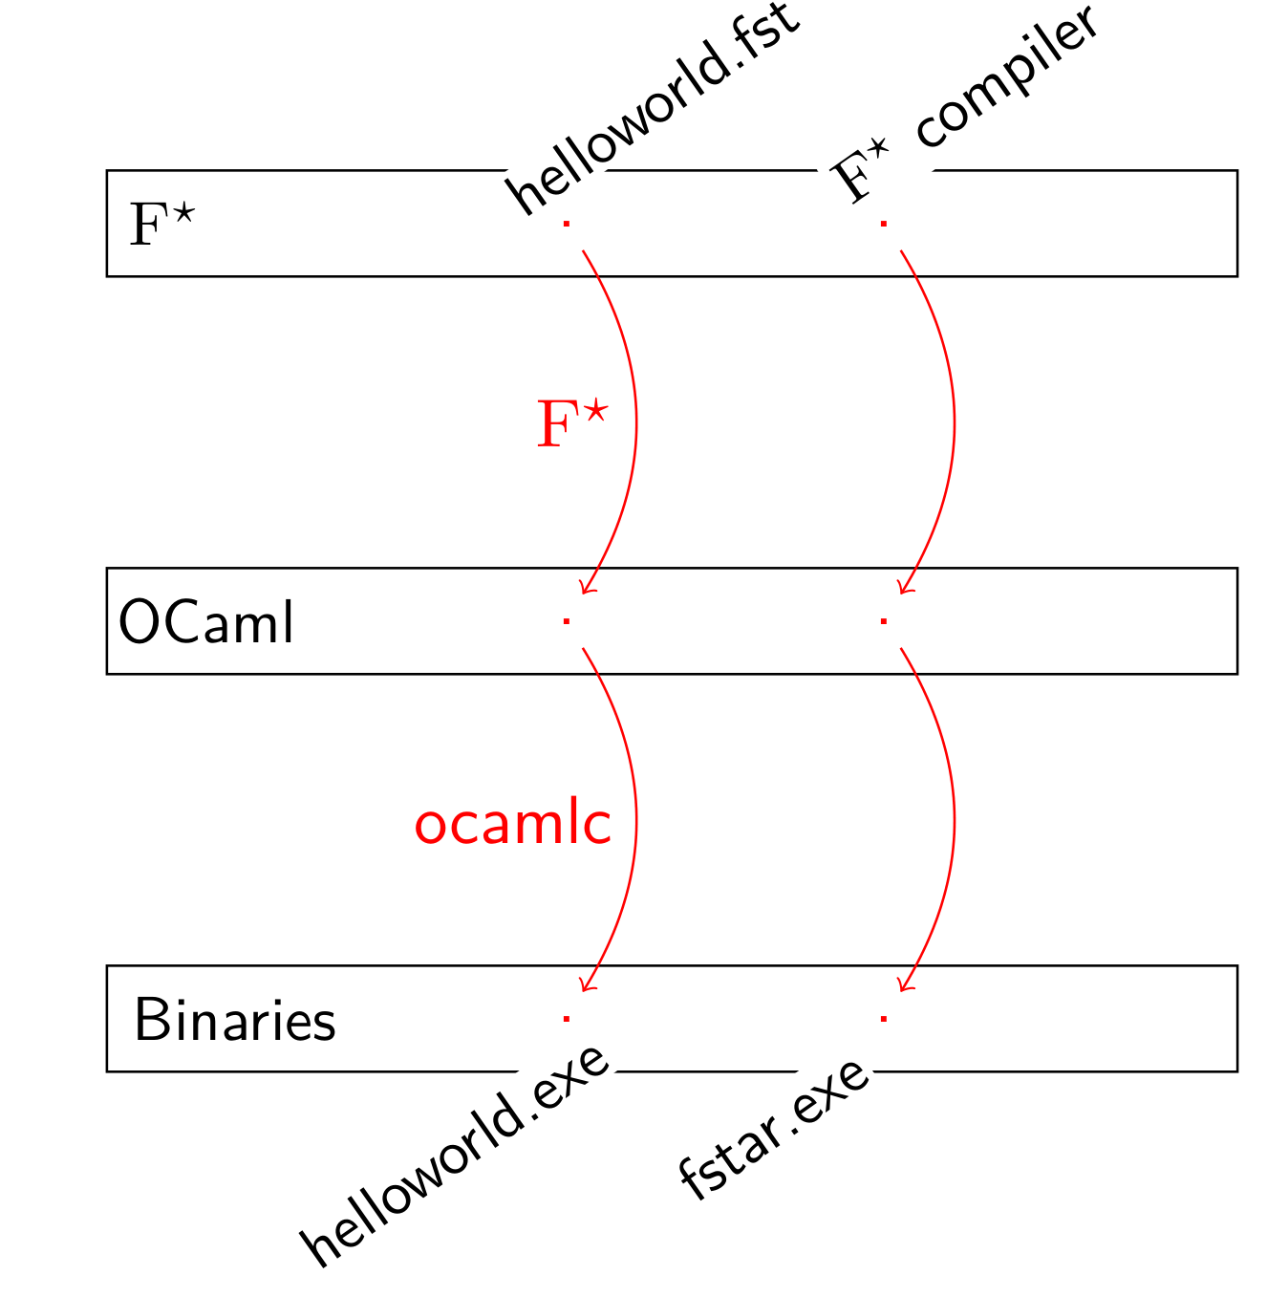
Executing metaprograms natively
By default, metaprograms are interpreted on F*’s normalizer
But, F* is implemented in F* and all F* programs can be compiled to OCaml

Slide 53
Execution across language boundaries
F* jumps back and forth between interpreter and native
Conversions at the boundary: deeply embedded (Tm_int “42”) to native (42) and conversely.
10x performance boost

Slide 54
Some takeaways
Freedom of expression
  Tools for large-scale, full program verification need arbitrary expressive power
Proof automation, Expressiveness, Control
  SMT is great, but not a panacea: Eventually hit a complexity/undecidability wall
Careful combination of tactics and SMT improve automation relative to either SMT or tactics alone
Meta-F*: Self-scripting a PL implementation with reflective metaprogramming; tactics are just a special case

Slide 55
Project Everest
Verified Secure Components
in the TLS Ecosystem
Meta-
TLS
SMT, metaprogramming and tactics for scalable, robust program proof
ECDH
AES
QUIC
RSA
SHA
…
Crypto Algorithms
Network buffers
https://fstar-lang.github.io
https://project-everest.github.io/
Untrusted network (TCP, UDP, …)
Notes:
Fully-verified standards-compliant replacement
- We will prove cryptographic security, not just eliminate bugs.
- As a result, we rule out both past attacks, and attacks we haven’t even thought of yet
Many academically successful verification projects. Few deployments.

Slide 56
Stream Encryption: Security Definition
plaintext
message
Attack at dawn!
…
Attack at
…
established connection (keys)
Client
Server
TL
plaintext
fragments
(padded)
Attack at
Attack at
dawn!
TLS record layer
decrypt
encrypt
#2
#1
ciphertext
fragments
3ef87abce4363
untrusted network
3ef87abce4363
a3b1684fbc770
…

Slide 57
Stream Encryption: Security Definition
plaintext
message
Attack at dawn!
…
Attack at
…
established connection (keys)
Client
Server
TL
plaintext
fragments
(padded)
ideal encryption log
Attack at
Attack at
dawn!
3ef87abce4363
Attack at
#0
#1
a3b1684fbc770
dawn!
…
…
…
decrypt
encrypt
random
sampling
table lookup
#2
#1
the adversary can distinguish between real and ideal
only with a small probability
ciphertext
fragments
3ef87abce4363
untrusted network
3ef87abce4363
a3b1684fbc770
…
Notes:
This is what we prove; this specificat

