Slide 1
Formal Computational Law
J. Protzenko (Microsoft Research)
Online Logic Seminar / Oct 13th, 2022

Slide 2
Formal Methods meet Computational Law
Formal Methods: treating programs as mathematical objects
logical predicates
deductive reasoning
symbolic testing
🤝
Computational Law: algorithms in legalese
tax law, pensions, benefits
contracts, compliance, policy
and much more in this talk
Notes:
talk about project everest!

Slide 3

The Formal Computational Law Project
Using the tools and methodologies of formal methods, applied to the law.
Collaborators & Interns:
🎓 🖥 Chris Bailey (U. of Illinois)
🖥 RC Carter (Microsoft)
🎓 🖥 Nel Escher (U. of Michigan)
🎓 Sarah Lawsky (Northwestern University)
🖥 Denis Merigoux (INRIA)
🖥 Leo de Moura (Microsoft Research)

Slide 4
From Computer Science to Law
What we want to avoid:
foreign-feeling technology (like PROLOG)
shallow properties (like ontologies)
lack of rigor and expressivity (likes rules-as-code, business logic)
ad-hoc and buggy code (“legal-tech”, with JS apps and PDF forms)
What we do:
bring the rigor of formal methods: specifications, proofs
use the toolkit of programming languages: compilers, domain-specific languages, semantics
prefer nimble approaches: no one-size-fits-all
team up with lawyers: co-design and co-development

Slide 5

Four success stories in formal computational law

Slide 6
A Story from France 🇫🇷
Income tax is automated: government runs the computation
Behind the scenes: 1990s-era custom code + hand-written C
Engineering problem: unusable, unmaintainable, inefficient
Sociological problem: unaccountable, unexplainable, unreproducible
“the existing infrastructure is made up of various parts pieced together and key data required to accurately reproduce computations was not shared with the public”
A Modern Compiler for the French Tax Code
D. Merigoux, R. Monat, Jonathan Protzenko
Notes:
post-WW2, generous family, housing benefits, social security, etc.

Slide 7
Another Story from France 🧀
Post-WW2: social security, retirement, family and housing benefits
Today: opaque implementations, resistance to open information laws
Case of housing benefits: a bug in the statute, but “the implementation is doing the right thing” → wrong specification!
“there were simplifications and that not all situations governed by law could be declared … the interpretations of the law taken into account in the computation might not always benefit the users”
Rules, Computation and Politics: Scrutinizing Unnoticed Programming Choices in French Housing Benefits.
Denis Merigoux, Marie Alauzen, Lilya Slimani
Notes:
post-WW2, generous family, housing benefits, social security, etc.

Slide 8
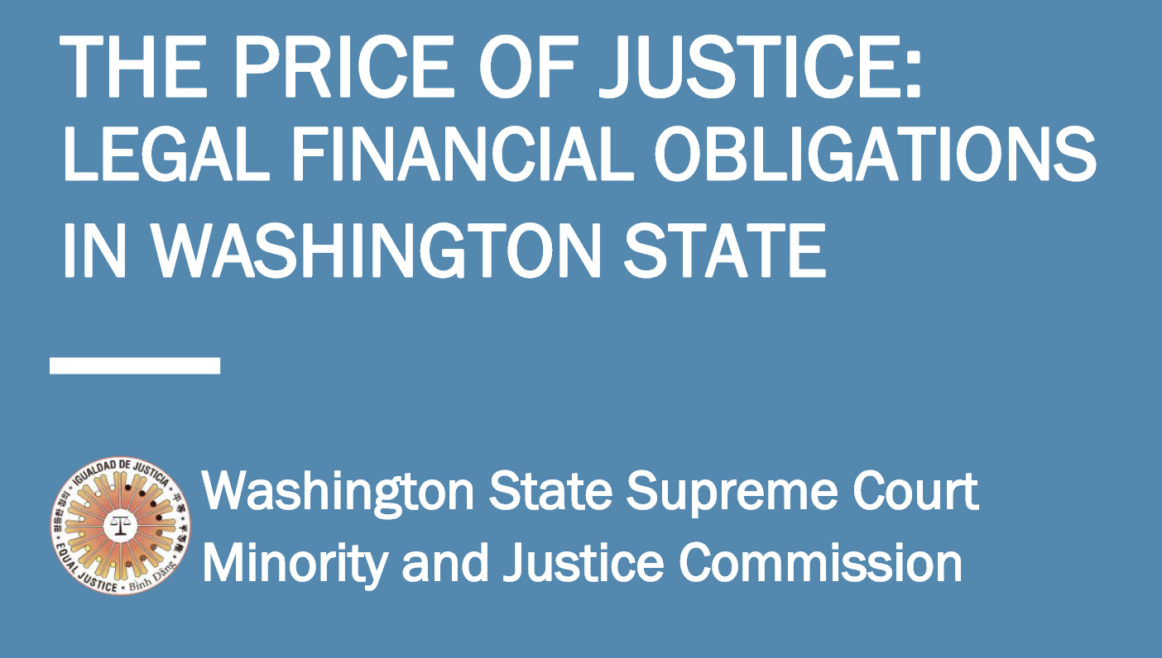
A Story from Washington State 🏔
Legal Financial Obligations (LFOs): a vast array of ~156 legal provisions for imposing monetary penalties on defendants.
In theory: unambiguous sentencing with clear guidelines.
In practice: “Latinx, Black, and Native Americans are sentenced to LFOs more frequently and at higher rates than Whites… The majority of defendants (80%-90%) who come to court are indigent… inconsistency in judges … widespread variation in how LFOs are assessed across jurisdictions.”

Slide 9
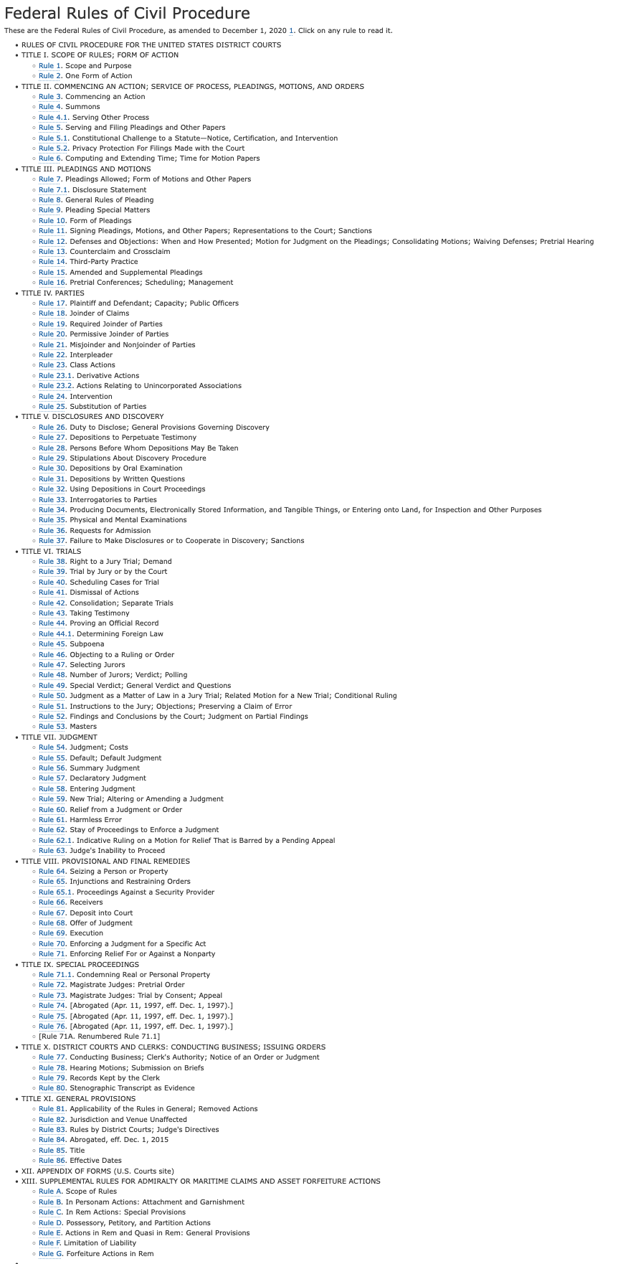
A Story from the US Federal Courts 🇺🇸
Civil procedure: a humongous amount of rules to follow if you don’t want to lose in a lawsuit.
State of affairs: hopeless if you don’t have a lawyer
Reality:
74% of low-income households had a civil problem in the past year
92% of those had no legal representation

Slide 10

These four stories are all identical

Slide 11
Legal-Technical Problems
The law must be implemented by legal experts who are ill-equipped and thus produce opaque and unaccountable implementations.
These situations demand a distinction between the intended behavior and its implementation.
This is formal verification (cf Everest): showing that the code exhibits the correct behavior
Notes:
elliptic curve just a critical as the income tax
in both cases, it’s critical software and it deserves the same level of care and attention in both cases
been doing that for crypto for a while, now merely looking at a different flavor of critical software, need to show it correct in both cases

Slide 12
Computational Law is Everywhere
Many parts of the law are not intended to be ambiguous! They’re only plagued with bad implementations.
- Tax law: personal, corporate…
- Welfare: retirement pensions, social benefits…
- Procedure rules: civil, corporate mergers, IPOs…
- Contract law: sale of goods, rentals & leases, insurance…

Slide 13
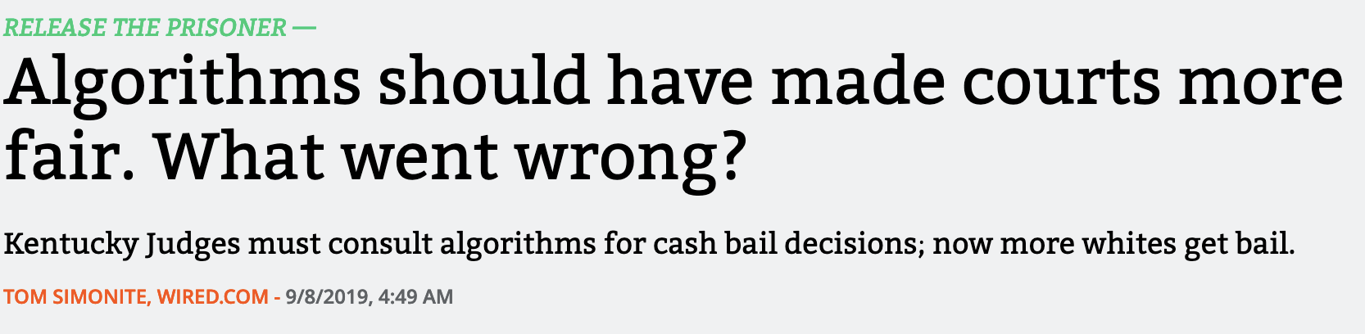
What is not Computational Law
Some parts of the law intend to leave things to appreciation: tort law, criminal juries – these are not in scope.
Some attempt to use AI to predict the law – terrible idea.

Slide 14
The emerging field of formal computational law

Slide 15
2022: The ProLaLa workshop
Programming Languages for the Law, affiliated with POPL.
First edition: 25 submissions, 60+ people in attendance.
Keynote: Programming Languages and Law: A Research Agenda for a New Field
Array of submissions, from Property Law to Business Logic, from Smart Contract DSLs to the Lean Proof Assistant…

Slide 16




Revisiting our Four Stories
problem difficulty
civil procedure
income tax
housing benefits
WA LFOs
technological solution

Slide 17

WA LFOs: a DSL, a data format, and more
Extensive legal review to classify LFOs with intern
Custom JSON data format that can be consumed by tools
Micro-DSL (domain specific language) to express “this LFO applies to this class of infractions”
For more complicated regulations, such as DUIs:

Slide 18
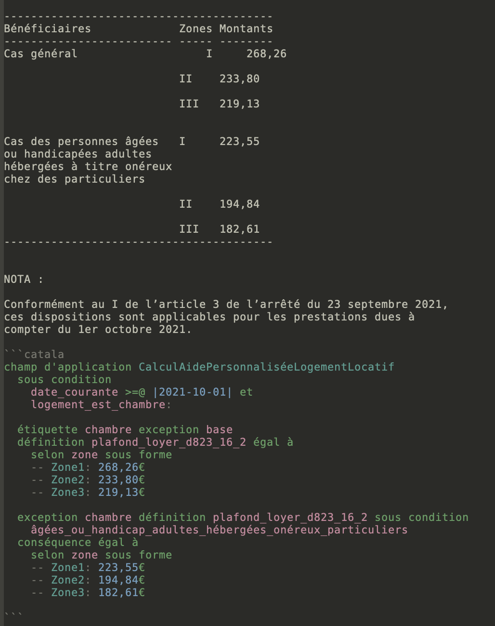
Follow the structure of the legal text via literate programming
Default calculus to express defeasibility
Verbose syntax syntax for lawyers, localized
Compilation to a variety of backends
Proof of soundness to make sure programs don’t crash for the wrong reasons
legal text
code

Slide 19
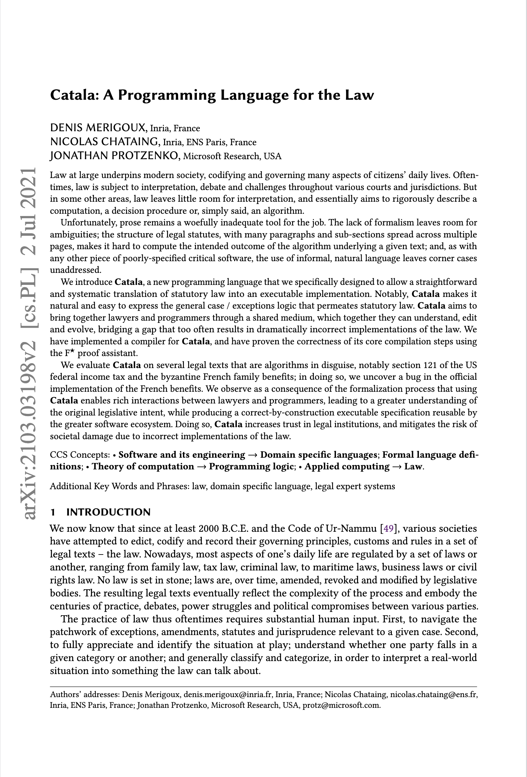
French Benefits using Catala
Catala, A (New) Programming Language for the Law
D. Merigoux, N. Chataing, Jonathan Protzenko – ICFP 2021
French housing allowance benefits rewritten in Catala.
-> Benefits: modern, auditable implementation that can be retrofitted into existing infrastructure.
-> Hardest part: convincing the government agency!

Slide 20
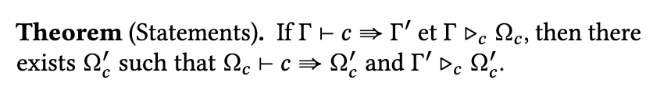
French Tax Code: from MLang to Catala
(Symbolic) Fuzzing, randomized testing, and reverse-engineering for the open-source re-implementation “MLang”
Language design for replacing the custom C code
Proof of soundness of MLang:
no bad corner cases
(Not scalable to reverse-engineer, re-design and re-implement every language, hence Catala.)

Slide 21
An in-depth look at Catala

Slide 22
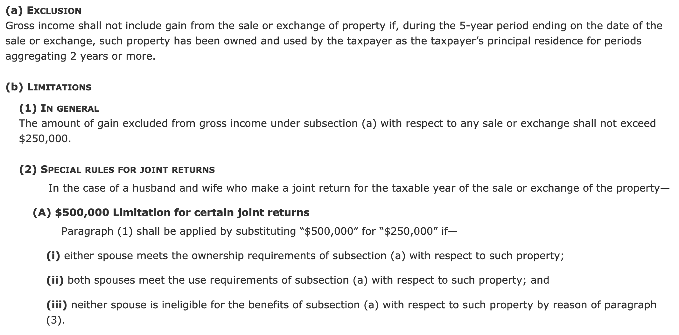
Law is a really weird language

Slide 23
Law is a really weird language
Base case + exceptions
  general feature of statutory law
  observed in US, France and most Western legal systems
Relevant information scattered
  need to skim through the entire document
  piecemeal definitions
Overrides
  replace previous definitions
  introduce concepts out of order

Slide 24

Software is a really weird language
None of the previous features
Cryptic syntax
Disconnect between legal text and its implementation
Catala is a domain-specific programming language designed for deriving correct-by-construction implementations from legislative texts.

Slide 25
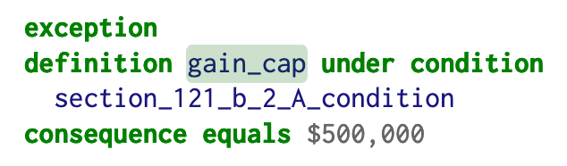
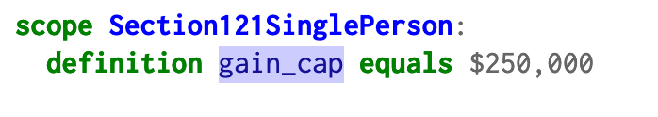
The default calculus
A model of the “base case + exceptions” logic
Catala: a usable programming language with default logic at its core
Exposed in the surface syntax via a definition possibly overridden by exceptions under certain conditions
first, the base case
much later, the exception

Slide 26
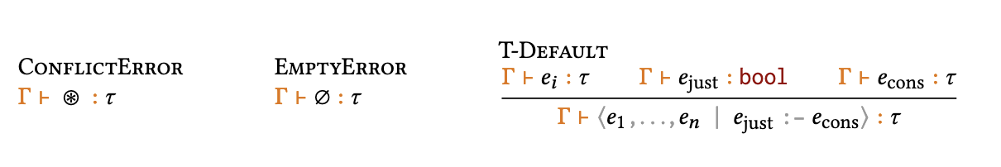
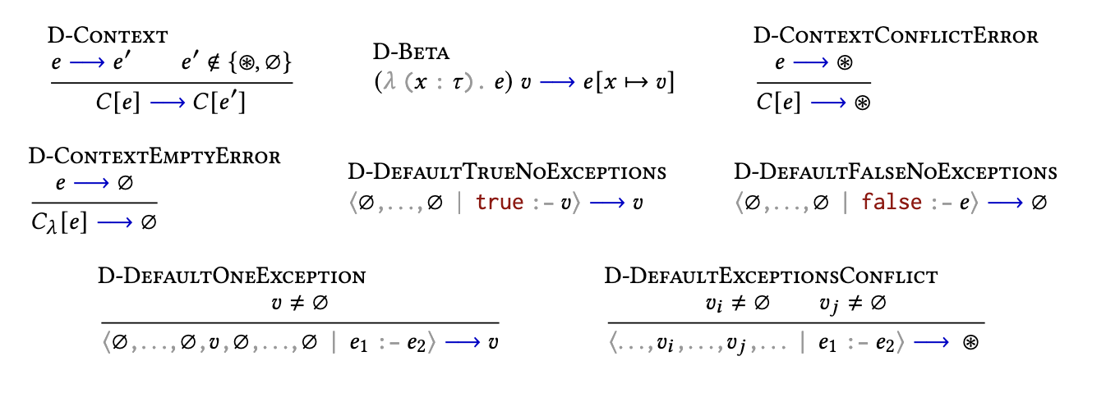
The default calculus
Step 1: the default operator ⤵️
Step 2:
reduction semantics ➡️

Slide 27
The default calculus
Compiled to a regular lambda-calculus with options and folds
Correctness of compilation scheme proven using F*
Enables a generic IR for the subsequent backends

Slide 28
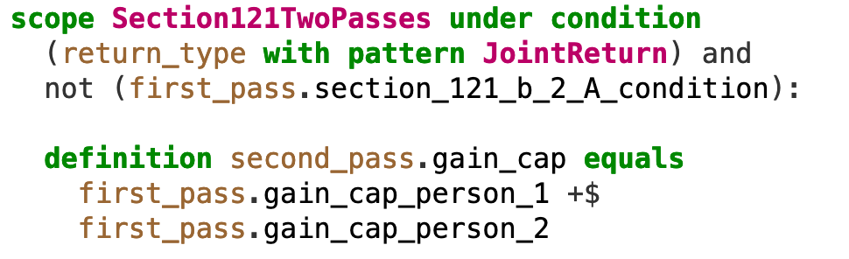
The scope mechanism
“Legal syntax” for function calls
Follows the structure of the law
Allows specifying none, part of, or all context-relevant parameters
Caller-specified arguments take precedence over default choices
we override the “gain cap” that we saw on the previous slide under certain conditions… the existing code is now executed with an overridden definition for the gain cap

Slide 29
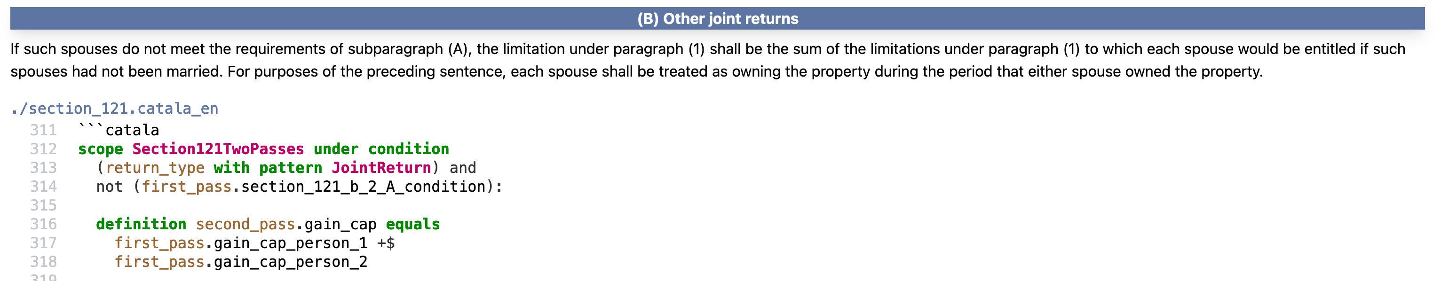
Literate programming
Old idea (Knuth in the 1970s)
Works wonders to get lawyers to follow along

Slide 30
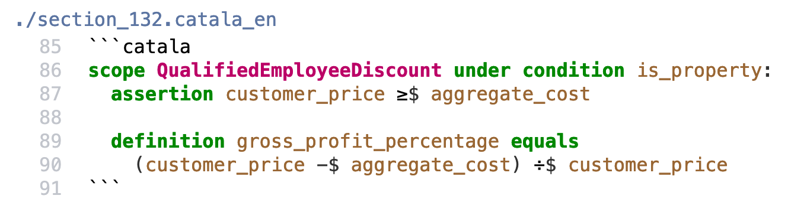
Very verbose syntax
Programmers are not paid per keystroke (hopefully)
Lawyers are less likely to run away from the “syntax wall”
Also has a French syntax, and more coming up

Slide 31
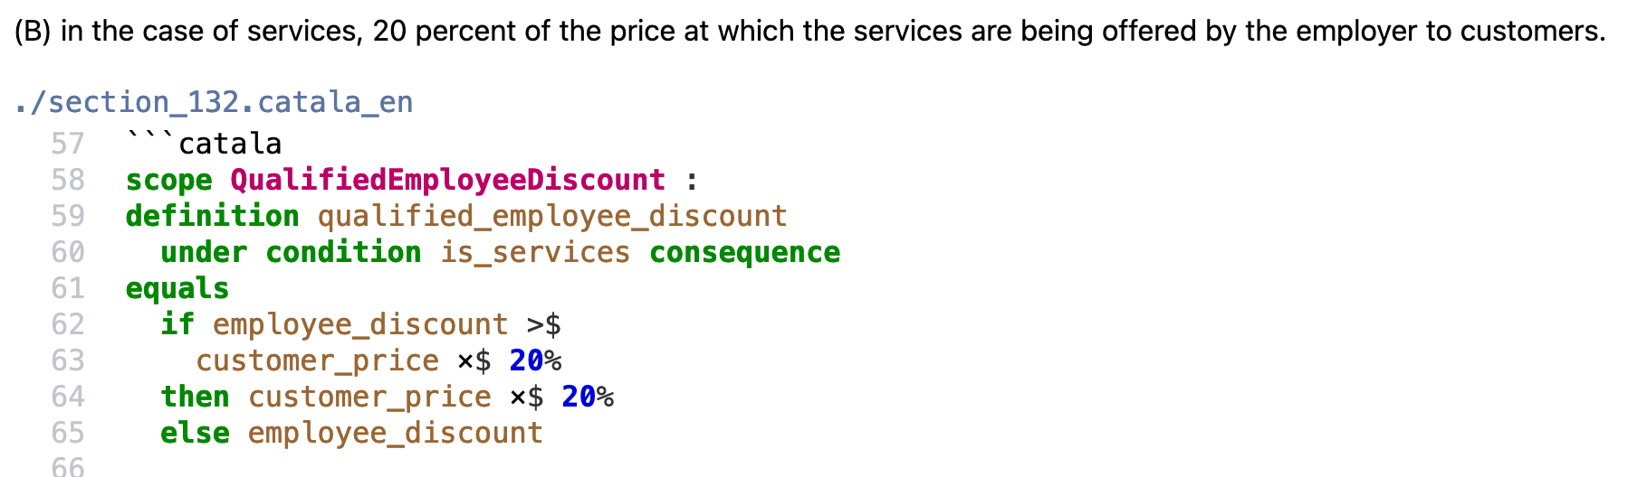
Built-in language support
Dedicated types for dates, durations (not the same!), money, etc.
Dedicated set of explicit operators -- we avoid overload for clarity
Forces the programmer to distinguish concepts in their mind

Slide 32
Why should you trust Catala?
Formalized semantics – we have described on paper how the language works, and checked it behaves properly (F*) + compilation
Rigorous implementation – written in OCaml for clarity, conciseness and reliability
Co-designed with lawyers to ensure it actually provides an answer to these legal problems
ICFP’21 -- https://arxiv.org/abs/2103.03198

Slide 33
Adoption
Having a new language is great. How do you get people to use it?
Tons of legacy environments. How do you get in?
Our core calculus is simple; we “transpile” to existing languages. Right now, we generate: OCaml code, and JavaScript code. Next: C, COBOL, etc.
Advantages:
no need to adopt new toolchain (processes are slow)
no need to have an FFI or even a notion of ABI

Slide 34
Looking ahead

Slide 35
A recap
Computational Law is everywhere
A panoply of tools to deal with each use-case
Combine PL and domain-specific knowledge

Slide 36
The Road Ahead
Broaden the scope & find more use-cases
Build applications to reach out more users
Improve usability, e.g. can NLP help parse a
given situation described in plain English?
With formal descriptions, we are assembling
training data for learning systems…

