Slide 1
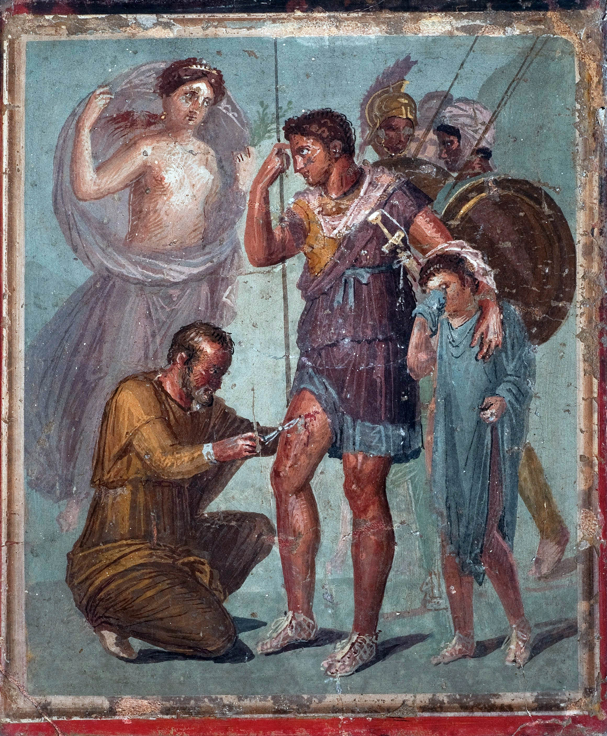
AENEAS from Rust Programs to Pure Lambda Calculus
Son Ho, Jonathan Protzenko
Rust programmer hurt by the borrow checker (allegory)
Rust Verification Workshop @ ETAPS / Munich / April 3rd 2022

Slide 2
How did we come to Rust Verification
2016-2020: Project Everest (HACL*, EverCrypt, Signal*)
F*: dependent types, effects, and SMT
Low*, a shallow embedding of C in Low* (Protzenko et al)
Stack & Heap memory model (via effects)
Distinguished libraries: machine integers, arrays, string literals, etc.
no separation logic; modifies-clause theory à la Dafny
location monoid + equational theory encoded via backwards-oriented SMT Patterns (T. Ramanandro, A. Rastogi)
2021: Noise*, a protocol compiler for 59+ protocols (Ho et al)
Still in Low*
Tour de force: associative lists in Low* implement an imperative map
Outside of the functional-spec, input-output, arrays-only typical usage of HACL*
There HAS to be a better way!

Slide 3
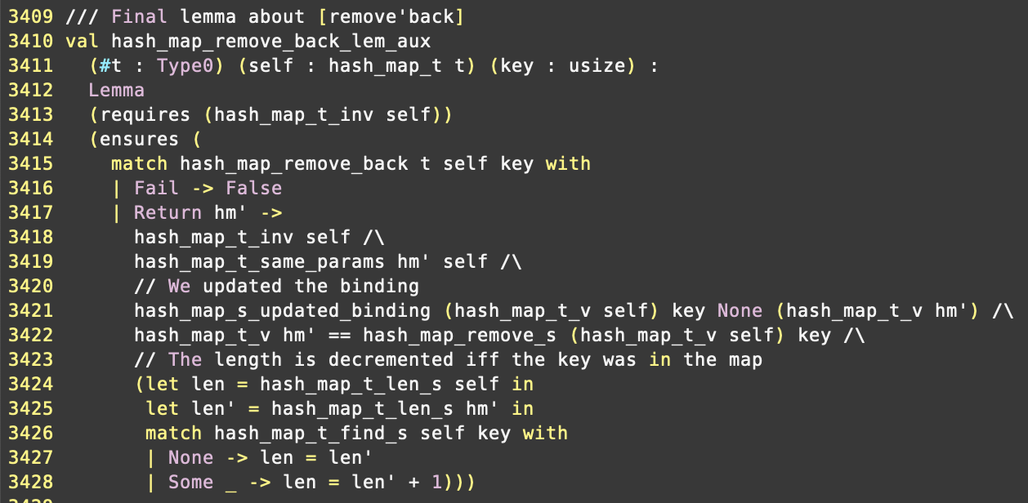
How did we come to Rust Verification (2)
What we no longer want to do:
What we’d rather do instead:

Slide 4
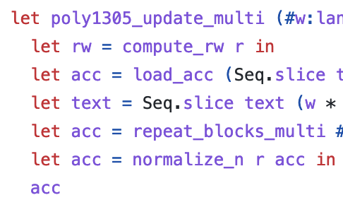
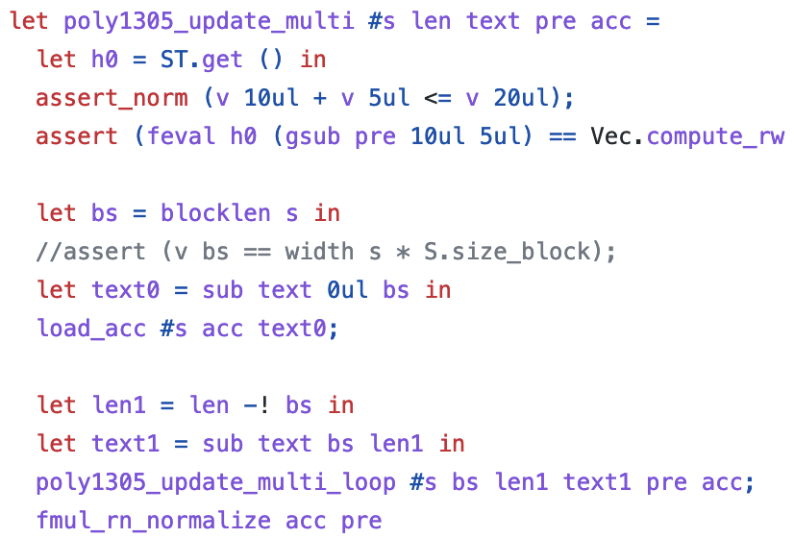
How did we come to Rust Verification (3)
Don’t want to pull separation logic out of the toolbox for simple things
Linked lists easier in separation logic, still requires book-keeping
Framing
Instantiating magic wands
Reasoning via stateful specifications
Things ought to be trivial when no aliasing is involved
Tired of writing a pure spec that is identical to the low-level code

Slide 5
How did we come to Rust Verification (4)
Observation 1: LOTS of effort and low-level expertise for things that ought to be simple
Observation 2: may-alias rarely important beyond very low-level code
Programming in the large? Rust.
Social: community is ok with a mean borrow-checker
Technical: Rust enforces many invariants “for free”
an ancient meme from back when one of the authors was in grad school (ca. 2010)

Slide 6
Aeneas, in a nutshell: safe Rust as a frontend
Old belief:
C-like languages: efficient code and precise control over memory but almost no guarantees from type system
Higher-level languages: powerful type system and safer memory management but poor performance (Java, OCaml, Haskell…)
Rust: combine advantages of both world
Dangling pointers?
Aliasing?
In C:
In Rust:
‘x’ and ‘y’ are live and disjoint

Slide 7
Aeneas, in a nutshell: translation + extrinsic
New point in the design space
functional, modular, type-based translation
no annotations in source program
translation to existing proof frameworks for extrinsic proofs (now: F*, ongoing : Coq, HOL4…)
Aim for verification in the large
no “tour de force” on ninja unsafe code
rather, properties about large applications written in safe Rust
A user-friendly semantics for borrows
slightly more expressive than lifetimes: borrow-checker “for free”
yields a functional, executable translation, hence a program proof pipeline

Slide 8
Pure Translation – Returning Unknown Borrows
fn choose<'a>(b : bool,
x : &'a mut i32,
y : &'a mut i32)
-> &'a mut i32 {
if b { x }
else { y }
}
let choose (b : bool) (x : i32) (y : i32) : i32 =
if b then x else y
let choose_back (b : bool) (x : i32) (y : i32) (z : i32) : i32 * i32 =
if b then (z, y) else (x, z)
// Usage example:
let x = 0;
let y = 1;
let pz = choose(true, &mut x, &mut y); // (i)
*pz = 2; // (ii)
// Lifetime 'a ends here - (iii)
assert!(x == 2);
assert!(y == 1);
...
let x = 0 in
let y = 1 in
let pz = choose true x y in // (i)
let pz = 2 in // (ii)
let (x, y) = choose_back true x y pz in // (iii)
assert(x == 2);
assert(y == 1);
...

Slide 9
Pure Translation – Lists & Recursion
pub enum List<T> {
Cons(T, Box<List<T>>),
Nil,
}
fn nth<'a, T>(l: &'a mut List<T>, i: u32) -> &'a mut T {
match l {
List::Nil => {
panic!()
}
List::Cons(x, tl) => {
if i == 0 {
return x;
} else {
return nth(tl, i - 1);
}
}
}
}
let rec nth_fwd (l: list u32) (i: u32) : result u32 =
match l with
| Nil -> Fail
| Cons x tl ->
if i = 0 then return x
else nth_fwd tl (i-1)
let rec nth_back (l: list u32) (i: u32) (n_x: u32) =
match l with
| Nil -> Fail
| Cons x tl ->
// If we reach the ith element:
// replace "x" with its new value
if i = 0 then Success (Cons n_x tl)
// Otherwise continue diving into the list
else
match nth_back tl (i-1) n_x with
| Fail -> Fail
| Success n_tl ->
// Replace "tl" with its new value
Success (Cons x n_tl)

Slide 10
Using Rust’s type system to simplify verification
Not a new idea:
Prusti (Viper): automate the application of memory reasoning rules
RustHornBelt/Creusot: “purification” through prophecy variables
⇒ both target user-friendly frontends and high-automation through SMT solvers via a logical encoding
Our project:
Exploit the fact that safe Rust is morally pure
Focus on absence of panics, functional correctness and security proofs
Target “expert” interactive theorem provers
⇒ translate safe Rust programs to idiomatic pure lambda calculus (executable)
⇒ generate code for several back-ends (Coq, F*, HOL4…)

Slide 11
Related work
Electrolysis (Rust to Lean)
Sebastian Ullrich’s Master’s Thesis: http://kha.github.io/electrolysis/
Really cool piece of work!
“Transpiler”, with no formal argument or semantic basis
Key limitation: returning borrows supported in a very limited fashion
Heapster
Paul He + “Galois Gang” + Steve Zdancewic, OOPSLA’21
Based on a logic of permissions slapped onto an LLVM program
Inserts dynamic checks as needed
Reason onto the pure functional specification

Slide 12
Things we like about our approach
Reason about pure programs: no notion of memory
Manual proof first, SMT later
Not tied to a particular language of annotations (hence not limited)
Semantic approach to borrows, as opposed to syntactic (lifetimes)
Generic translation, not influenced by any particular target’s machinery
Modularity
integrate translation into existing proof development and connect to the rest (e.g., HACL* specs)
type-based analysis, so modular translation, natural handling of externals, etc.
translation can itself proceed in parallel over e.g. multiple crates

Slide 13
How does it work?
A logic of permissions (Heapster, RefinedC, Mezzo, etc.)
A notion of region abstraction (a.k.a. magic wand)
A synthesis procedure where ending a region (lifetime) calls the backward function
Allows us to deal with borrow-returning functions (the hard part)

Slide 14
Example: mutable borrows

Slide 15
Example: immutable borrows

Slide 16
Example: region abstraction

Slide 17
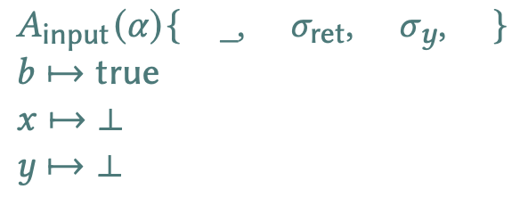
Example: translation, symbolic values

Slide 18
What did we do?
Symbolic execution
Accurate tracking of aliasing (tree)
Abstract aliasing information via “region abstractions”
Lifetime identifiers tell us how to “return ownership”, i.e. implement the backward function
Forward/backward ≈ focus / give back for lenses
Gist of our approach: lenses “on steroids” synthesized thanks to ownership information

Slide 19
What did we also do?
A new semantics for the borrow checker
Based on a flow-sensitive, symbolic execution
Can inform future evolutions of the borrow checker
→ an exciting sub-project

Slide 20
Where are we?
Targeted subset:
Safe rust without interior mutability
Additional temporary restrictions:
No nested borrows in function signatures (+ minor restrictions)
No loops (see next)
No function pointers, closures, traits
Restrictions on type parametricity (no borrows in type parameters)
What we have:
Types with mutual recursion
Functions with mutual recursion
Shared and mutable borrows (if not in enums/structs for now)
Some types and functions from the standard library: box, vec, option

Slide 21
Opaque Functions - Serialized Hashmap Example
Remember: Aeneas is entirely type-based (hence modular)
External dependencies?
Declarations without implementations
Mark a module as opaque « wholesale »
Rust :
F* :
// utils.rs (module declared as opaque)
fn serialize(hm: HashMap<u64>) { … }
fn deserialize() -> HashMap<u64> { … }
// hashmap.rs (non opaque)
fn insert_on_disk(key: Key, value: u64) {
let mut hm = deserialize();
hm.insert(key, value);
serialize(hm);
}
// Utils.fsti (interface file)
type state : Type
val deserialize_fwd : state -> result (state & hash_map_t u64)
val serialize_fwd : hash_map_t u64 -> state -> result (state & unit)
// Hashmap.fst
let insert_on_disk_fwd (key : usize) (value : u64) :
state -> result (state & unit) =
hm <-- deserialize_fwd;
hm <-- insert_fwd_back u64 hm key value;
_ <-- serialize_fwd hm

Slide 22
Charon and Aeneas
Charon:
Interface with Rust compiler (mostly engineering), written in Rust
Extracts MIR types and functions to an “easy-to-use” AST exported to Json
Computes the dependency graphs, reorders the definitions, groups the mutually recursive definitions
Reconstructs control-flow
Extracts name information, constants, etc.
Meant to be reused for other projects
Aeneas:
Translation mechanism, written in OCaml
Goal: target several theorem provers (for now, only F*)

Slide 23
Ongoing work: Loops / Translating blocks
There is a general problem of translating blocks of code in isolation:
// Rust
let x = 0;
if b { x = 1; }
else { x = 2; }
let y = x + 1;
...
// Current translation
let x = 0;
if b then
let x = 1 in
let y = x + 1 in
...
else
let x = 2 in
let y = x + 1 in
...
// Target translation
let x = 0;
let x = if b then 1 else 2 in
let y = x + 1 in
...
Idea: find a “block signature” and get back to function case

Slide 24
Discussion – Nested Borrows
The real difficulty is dealing with nested lifetimes
fn id_mut_mut(ppx : &'a mut &'b mut u32)
-> &'a mut &'b mut u32 {
x
}
let mut x = 0;
let mut px = &mut x;
let ppx = &mut px;
let mppx = &mut (*ppx);
let ppy = id_mut_mut(move mppx);
**ppy = 1; // Updates x
let mut y = 2;
*ppy = &mut y; // ← Now, (**ppx) == y
assert!(**ppx == 2); // This ends 'a
**ppx = 3; // ← We update y!
assert!(x == 1); // This ends 'b
assert!(y == 3);
// If we allow arbitrary type instantiations, we
// can turn any innocent looking function into
// something very complex:
fn id<T>(x : T) -> T { x }
// This is similar to what is on the left:
...
let mppx = &mut (*ppx);
let ppy = id<&mut &mut u32>(move mppx);
...

Slide 25
Discussion – Nested Borrows – Use Cases
What are the use cases for nested lifetimes (real question)?
The only use case we are aware of is degenerate:
// This function is very idiomatic
fn f<'b, 'a>(ctx : &'b mut Ctx<'a>, ...) {
// However the following “borrow overwrites” seem non-idiomatic:
ctx.x = &mut ...;
}
fn g<'b, 'a>(...) -> &'b mut Ctx<'a>;
// The following “borrow overwrites” seem even less idiomatic:
ctx.x = &mut ...;
Choose a subset which forbids the difficult operations?
We are interested in use cases for “borrow overwrites”!

Slide 26
Looking forward
Add at least one truly interactive backend (Coq, Lean)
Support for interior mutability (a.k.a. arbitrary aliasing) via Iris, or Iris-in-Lean
Address limitations before
Large examples:
hashmap: done
B-epsilon-tree: ongoing (hi Chris!)

Slide 27
Aeneas: Rust verification by Functional Translation
Semantic approach to borrows
Guides a functional translation
Backward function mechanism captures end-of-region, akin to lenses
Import the output of the translation into your favorite theorem prover
Implemented in Rust + OCaml
Aiming to verify a very large project soon!
Questions?

Slide 28
Aeneas?!
aēnea “copper, bronze… brazen”
AEN∃∀ (nice central symmetry)
But… too close to the Lean Theorem Prover
Final version: Aeneas, after the Greek hero, son of Aphrodite
Aeneas slaying bugs (allegory)

Slide 29
Pure Translation – Proof of Concept (loops) (i)
fn list_iterator_has_next<'a, T>(l: &'a List<T>) -> bool {
match l {
List::Nil => {
return false;
}
List::Cons(_, _) => {
return true;
}
}
}
fn list_iterator_get_next<'a, T>(l: &'a mut List<T>) -> (&'a mut T, &'a mut List<T>) {
match l {
List::Nil => {
panic!();
}
List::Cons(x, tl) => {
return (x, tl);
}
}
}
let list_iterator_has_next (#a : Type0) (l : list a) : bool =
match l with
| [] -> false
| x :: l -> true
let list_iterator_get_next_fwd (#a : Type0) (l : list a) : result (a & tl:list a{tl << l}) =
match l with
| [] -> Fail
| x :: tl -> Success (x, tl)
let list_iterator_get_next_back
(#a : Type0) (l : list a) // Old value of the list
(n_x : a) (n_tl : list a) :
// return: the reconstructed list
list a =
n_x :: n_tl

Slide 30
Pure Translation – Proof of Concept (loops) (ii)
fn list_iterator_test1(mut l: &mut List<u32>) {
while list_iterator_has_next(l) {
let (x, tl) = list_iterator_get_next(l); // Reborrow (i)
*x = *x + 1;
l = tl; // Reborrow (ii)
}
}
let rec list_iterator_test1 (l0 : list u32) : result (list u32) =
// > while list_iterator_has_next(l) {
if list_iterator_has_next l0 then
begin
// > let (x, tl) = list_iterator_get_next(l);
// This introduces a borrow on l, that we designate
// as the borrow (i)
tmp <-- list_iterator_get_next_fwd l0;
let (x0, tl0) = tmp in
x1 <-- check_add x0 1; // > *x = *x + 1;
let l1 = tl0 in // > l = tl; // Borrow (ii)
// Recursive call: end of the loop (mental model: we completely unfold the loop)
// We get the new value of l
l2 <-- list_iterator_test1 l1;
// Reborrows expire: propagate the values back
let tl1 = l2 in // End borrow (ii)
let l3 = list_iterator_get_next_back l0 x1 tl1 in // End borrow (i)
return l3
end
else
return l0

