Slide 1





Building and Deploying
Verified Components in the HTTPS Ecosystem
*the Everest VERified End-to-end Secure Transport
J. Protzenko
Notes:
MSR Cambridge Technical Advisory Board, May 24.
miTLS: our main verified-cryptograph project since 2013; papers, research prototypes, etc.
Everest: a new, more ambitious 5-year research project, just starting.

Slide 2
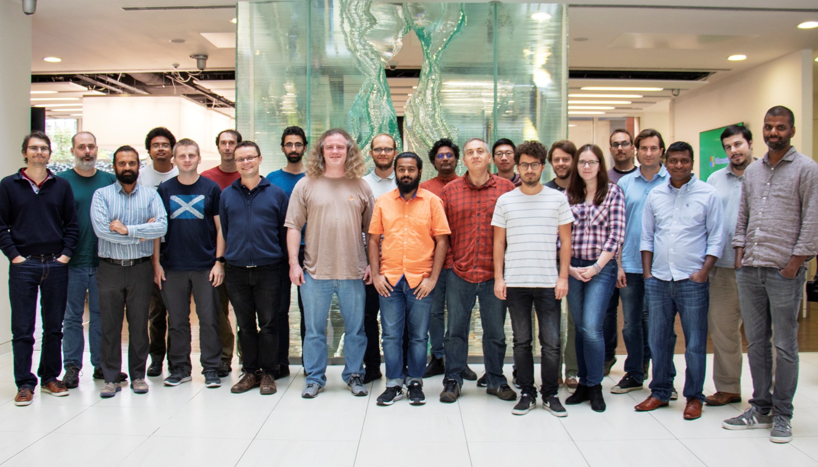
MSR Redmond
  Barry Bond
  Chris Hawblitzel
  Qunyan Magnus
  Kiran Muthabatulla
  Jonathan Protzenko
  Tahina Ramananandro
  Nikhil Swamy
  Gustavo Varo
MSR Cambridge
  Antoine Delignat-Lavaud
  Cédric Fournet
  Christoph M. Wintersteiger
  Santiago Zanella-Béguelin
MSR India
  Aseem Rastogi
INRIA Paris
  Danel Ahman
  Kenji Maillard
  Benjamin Beurdouche
  Karthikeyan Bhargavan
  Victor Dumitrescu
  Cătălin Hriţcu
  Marina Polubelova
CMU (Pittsburgh)
  Jay Bosamiya
  Aymeric Fromherz
  Bryan Parno
Edinburgh
  Markulf Kohlweiss
Interns, open-source contributors, visitors, alumns
Guido Martinez
Zoe Paraskevopoulou
Yao Li
Joonwon Choi
Clément Pit-Claudel
Nick Giannarakis
Niklas Grimm
Anita Gollamudi
Nadim Kobeissi
Matteo Maffei
Asher Manning
Monal Narasimhamurthy
Gordon Plotkin
Perry Wang
Jean-Karim Zinzindohoue
2016 -- present

Slide 3
The HTTPS Ecosystem is critical
Services & Applications
Edge
cURL
WebKit
Skype
IIS
Apache
Nginx
Clients
Servers
HTTPS Ecosystem
Most widely deployed security?
½ Internet traffic (+40%/year)
Web, cloud, email, VoIP, 802.1x, VPNs, …
Notes:
HTTPS foundation of Internet Security, from mobile users to cloud services.
Encryption will be mandatory with HTTP/2.
Critical infrastructure for Microsoft (and many others).
Security best practices say don’t invent your own, so everyone uses tools like HTTPS.

Slide 4
The HTTPS Ecosystem is complex
Services & Applications
Edge
cURL
WebKit
Skype
IIS
Apache
Nginx
Clients
Servers
HTTPS
Certification Authority
X.509
ASN.1
TLS
***
RSA
SHA
ECDH
4Q
Crypto Algorithms
Network buffers
Untrusted network (TCP, UDP, …)
Notes:
Distributed system, networking, cryptography.
Complex, but not necessarily large.
Smaller than a browser or an OS, for example.
Amenable to formal verification.

Slide 5


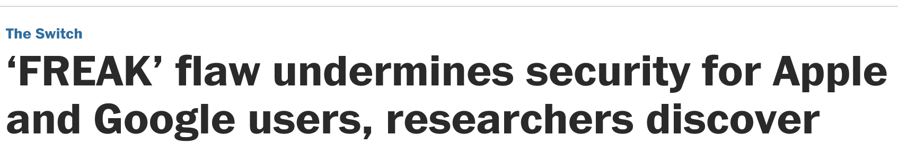
The HTTPS Ecosystem is broken
20 years of attacks & fixes
Buffer overflows
Incorrect state machines
Lax certificate parsing
Weak or poorly implemented crypto
Side channels
Informal security goals
Dangerous APIs
Flawed standards
Mainstream implementations
OpenSSL, SChannel, NSS, …
Still patched every month!
Services & Applications
Edge
cURL
WebKit
Skype
IIS
Apache
Nginx
Clients
Servers
HTTPS
Certification Authority
X.509
ASN.1
TLS
***
RSA
SHA
ECDH
4Q
Crypto Algorithms
Network buffers
Untrusted network (TCP, UDP, …)
Notes:
Many attacks and fixes.
More fundamental problems.
For example, the security goals are informal, revised after some attacks.
The APIs are hard to use securely—many misconfigured clients and servers.
And we found flaws in the standards too, not just their implementations.

Slide 6



Everest 2016—2021:
Verified Components
for the HTTPS
Ecosystem
Services & Applications
Edge
cURL
WebKit
Skype
IIS
Apache
Nginx
Clients
Servers
HTTPS
Certification Authority
X.509
ASN.1
Strong verified security
Widespread deployment
Trustworthy, usable tools
Growing expertise in
high-assurance software
development
TLS
***
RSA
SHA
ECDH
AES
Crypto Algorithms
Network buffers
Untrusted network (TCP, UDP, …)
Notes:
Fully-verified standards-compliant replacement
- We will prove cryptographic security, not just eliminate bugs.
- As a result, we rule out both past attacks, and attacks we haven’t even thought of yet
Many academically successful verification projects. Few deployments.

Slide 7
Verification Tools and Methodology
F*: A general purpose
programming language
and verification
tool
val poly1305_mac: tag:nbytes 16 →
len:u32 →
msg:nbytes len{disjoint tag msg} →
key:nbytes 32 {disjoint msg key ∧ disjoint tag key} →
ST unit
  (requires (λ h → msg ∈ h ∧ key ∈ h ∧ tag ∈ h))
  (ensures (λ h0 _ h1 →
  let r=Spec.clamp h0.[sub key 0 16] in
  let s=h0.[sub key 16 16] in
  modifies {tag} h0 h1 ∧
  h1.[tag] == Spec.mac_1305 (encode_bytes h0.[msg]) r s))
Math spec in F*
poly1305_mac computes a polynomial in GF(2¹³⁰-5),
storing the result in tag,
and not modifying anything else
kreMLin
void
poly1305_mac(uint8_t *tag, uint32_t len, uint8_t *msg, uint8_t *key)
{
uint64_t tmp [10] = { 0 };
uint64_t *acc = tmp
uint64_t *r = tmp + (uint32_t)5;
uint8_t s[16] = { 0 };
Crypto_Symmetric_Poly1305_poly1305_init(r, s, key);
Crypto_Symmetric_Poly1305_poly1305_process(msg, len, acc, r);
Crypto_Symmetric_Poly1305_poly1305_finish(tag, acc, s);
}
Compiler from
(a subset of)
F* to C
Efficient C implementation
Verification imposes no runtime performance overhead
C
Notes:
Long-term research effort, not specific to communications security.
By necessity we will improve our tools and their usability.
Automation is key (Z3)
Format a bit

Slide 8
Secure components: Where we are today
Close to production quality
HACL*: High-assurance Crypto Library
  Verified implementations of crypto algorithms
  Performance comparable to hand-written C
  Functionally correct, cryptographically secure,
  side-channel resistant, in Firefox Quantum
VALE: Verified Assembly for Everest
  Assembly level crypto, with performance comparable to OpenSSL assembly
TLS Record Layer Protection:
  Verified, efficient code compiled to C
  Functionally correct, cryptographically secure,
  reasonably fast [used in Windows prototype]
Research prototypes
TLS 1.3 full protocol
  1 year of interop with
  other early implementations
  Deployments within existing
  clients (IE, Curl) and servers (nginx)
  Partial verification (in progress)
QUIC library
  A TLS handshake library suitable for use from QUIC

Slide 9


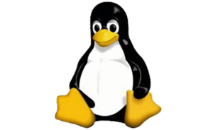
Everest in Action, so far
Production deployments of Everest Verified Cryptography
WinQUIC: Delivered Everest TLS 1.3 and crypto stack to Windows Networking, in the latest Windows developer previews
Mozilla NSS runs Everest verified crypto for several core algorithms
Everest verified crypto in the Linux kernel via WireGuard secure VPN
Notes:
Fully-verified standards-compliant replacement
- We will prove cryptographic security, not just eliminate bugs.
- As a result, we rule out both past attacks, and attacks we haven’t even thought of yet
Many academically successful verification projects. Few deployments.

Slide 10




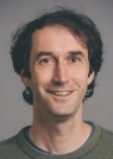



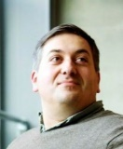

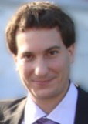

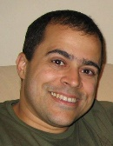



Team Members
Security
Cambridge
Systems
and Engineering
Bangalore
Patrice
Godefroid
Aseem
Rastogi
+3
Redmond
Barry Bond
Antoine
Delignat-Lavaud
Paris (INRIA)
Gustavo
Varo
Pittsburgh (CMU)
Chris
Hawblitzel
+2
Nik Swamy
Edinburgh
Bryan Parno
Catalin Hritcu
Karthik
Bhargavan
Cédric
Fournet
Jonathan Protzenko
Markulf
Kohlweiss
Santiago
Zanella-Beguelin
Cryptology
+4
Leonardo
de Moura
Christoph Wintersteiger
Tahina
Ramanandro
PL/Verification
Notes:
A great team of researchers from 5 labs
Diversity: Programming languages, verification, systems, security

Slide 11
What is actually verified?

Slide 12
Goal: High-assurance security components
Showing why they are trustworthy, not just asking for trust.
Method: Computer-aided verification
We develop clean-slate, modular, verification-oriented models, specifications, and implementations.
We co-develop compilers & provers to automatically check that implementations meets their (simpler) functional and security specifications.
Notes:
This provides strong evidence of security: anyone can review our code, models, papers, formal specifications, and tools; anyone can check (and test) their compliance to standardized informal specifications; anyone can replay our mechanized proofs. The methodology itself benefits from decades of research in security, cryptography, programming languages, and verification.
We believe this is well worth the effort for critical Internet infrastructure, and will become standard best practice. Notably, this can prevent embarrassing vulnerabilities, which are still surprisingly frequent, undermine confidence in the cloud infrastructure, and can be very costly to remediate after the fact. (Anecdotal evidence includes uncovering several serious security vulnerabilities, e.g. 3Handshake, FREAK, and LOGJAM and fixing defects in draft standards as part of our verification effort.)

Slide 13
What do we verify?
Safety
  Memory- and type-safety. Mitigates buffer overruns, dangling pointers, code injections.
Functional correctness
  Our fast implementations behave precisely as our simpler specifications.
Secrecy
  Access to secrets, including crypto keys and private app data is restricted according to design.
Cryptographic security
  We bound the probability that an attacker may break any secrecy or integrity properties
Our specifications and implementations are written together, in one language (F*)
Drift between spec and implementation cannot happen.
Notes:
Secrecy includes side-channel resistance.
All of this applies to both code in F* and in Vale. We verify the assembly code follows the “rules of the road” for calling convention, as well as that no secrets are leaked on the stack or in any register (even x86 EFLAGS) when we return out of assembly code.

Slide 14
Will Everest be perfectly secure? No.
Our models make assumptions, e.g.
  The private signing key must remain private and not used in other protocols
  We assume security for core crypto algorithms, based on hard problems.
Our models may not be complete
  Our detailed models are designed to exclude all known attacks,
  but may be blind to new classes of attack (hardware faults,…)
Our verification toolchain may be buggy
  Our TCB includes Z3, Kremlin, C compilers… Efforts to reduce it are under way.
Computer-aided verification also has advantages: once in place, proof verification is
automated (but takes hours)
compositional (we can re-use verified component as building blocks for others)
maintainable (we can extend or modify our code, and re-check everything as part of CI).
Notes:
To reduce the TCB, we can target CompCert, use alternate solvers, etc.

Slide 15

TLS: The main protocol
HTTPS
X.509
ASN.1
TLS
***
RSA
SHA
ECDH
4Q
Crypto Algorithms
Network buffers
Notes:
Overview of the HTTPS ecosystem, focusing on prior results on TLS.
A few words on X.509, HTTPS, and crypto algorithms.

Slide 16
Cryptographic protocol: TLS
Internet Standard
  1994 Netscape’s Secure Sockets Layer
  1995 SSL3
  1999 TLS 1.0 (≈SSL3)
  2006 TLS 1.1
  2008 TLS 1.2
  2018? TLS 1.3
Implementations:
OpenSSL SChannel NSS SecureTransport PolarSSL JSSE GnuTLS miTLS
  Large C++ codebase (400K LOC), many forks https://github.com/openssl/openssl
  Optimized cryptography for 50 platforms
  Terrible API
  Frequent critical patches https://openssl.org/news/vulnerabilities.html
  Never secure so far
Notes:
Stats for OpenSSL
34 CVEs just in 2015
60 kLOC for the protocol
55 kLOC for ASN.1 and X.509
200 kLOC for crypto algorithms (150 sym, 20 asym, 80 curves)

Slide 17
High-Profile TLS Attacks
Crypto
failures
MD5
RC4
RSA 512 bit
SHA1
SLOTH
DROWN
Renegotiation
Attack
CRIME
Triple Handshake
Protocol
weaknesses
ECDHE Cross-protocol Attack
BEAST
(Rogaway 02)
Logjam
Lucky13
POODLE
FREAK
OpenSSL entropy
EarlyCCS
Implementation
bugs
Heartbleed
SKIP
2007 2008 2009 2010 2011 2012 2013 2014 2015 2016
Notes:
3 classes; overlapping. More scrutiny (Snowden); leading to more attacks being uncovered.
Yellow = attacks
Orange = practical attacks
Red = attacks we found and helped fixed.

Slide 18
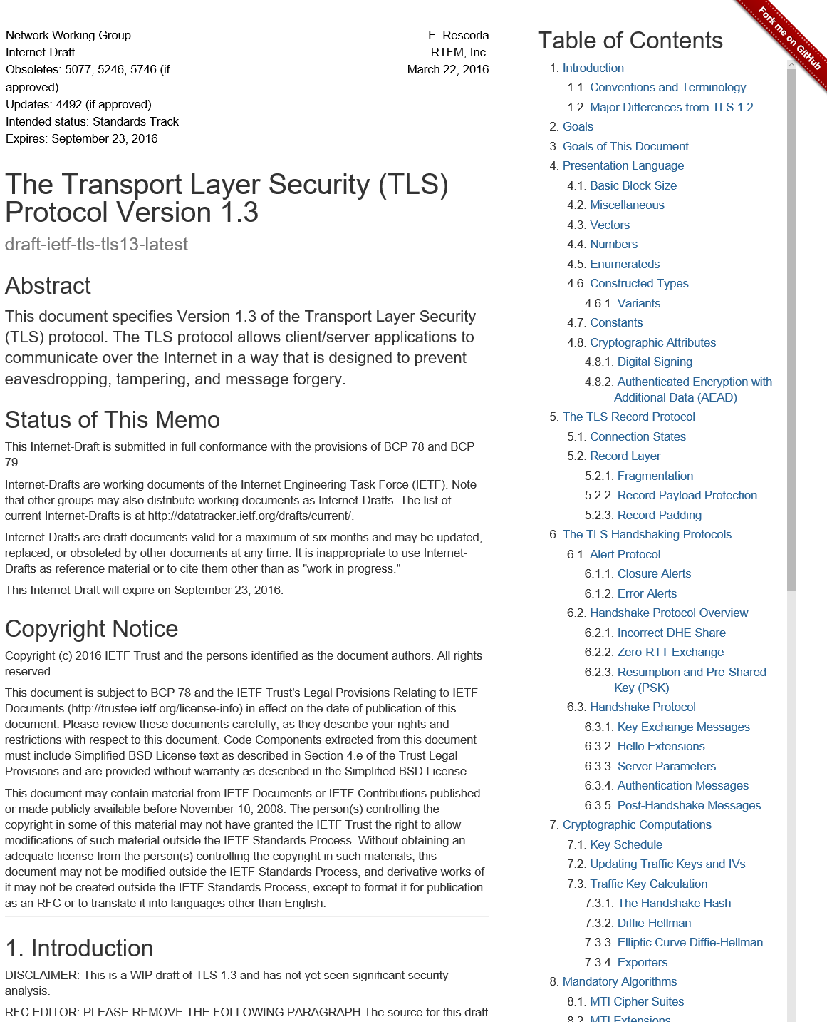
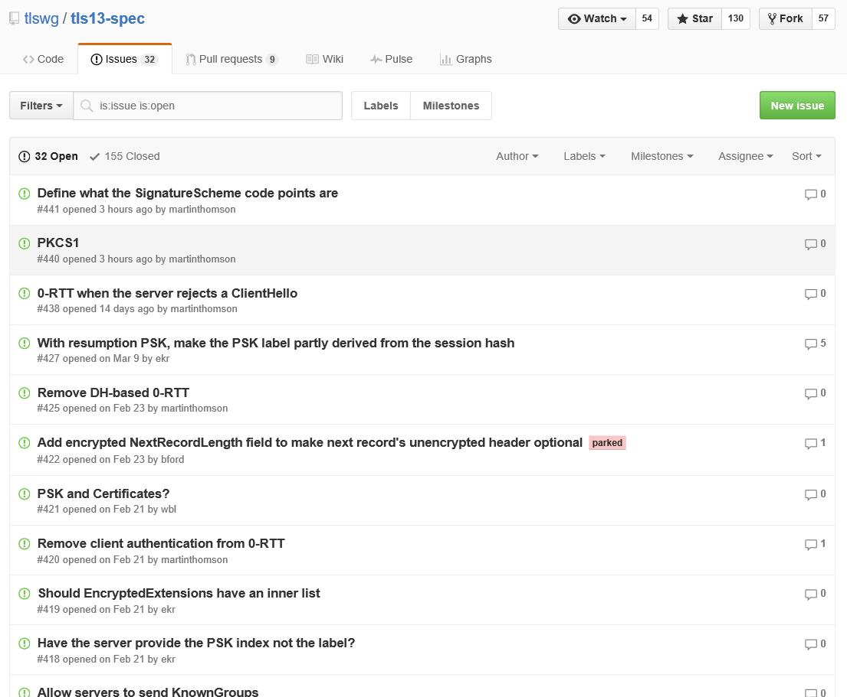
TLS 1.3: a new hope
Much discussions
  IETF, Google, Mozilla, Microsoft, CDNs,
  cryptographers, network engineers, …
Much improvements
  Modern design
  Fewer roundtrips
  Stronger security
New implementations
required for all
  An early implementer and verified too!
  Find & fix flaws before it’s too late
20th draft including
many of our proposals
  #4 log-based key separation
  extended session hashes
  (fixing attacks we found on 1.2)
  #11 stream terminators
  (eventually fixing an attack)
  #14 downgrade resilience
  #15 session ticket format
  #17 simplified key schedule
  pre-shared-key 0RTT
  #18 PSK binding (fixing an attack)
And our verified reference implementation of the
record layer
Notes:
IETF drafting the new standard.

Slide 19
Save roundtrips to lower latency
TLS over TCP
Client
Server
Client
Server
Client
Server
Syn
Syn
Syn
0
Ack
0
0
    Latency matters
    Amazon: 100ms ~ 1% rev.
    Bing: 3.5ms ~ 1 dev / yr
Hello
Hello
Hello
Hello
Hello, Finished
Hello, Finished
0.5
1
1
Finished
Finished
1
Finished
Finished
2
2
2
TLS 1.2
TLS 1.3
TLS 1.3
Two roundtrips before sending
application data
One roundtrip before sending
application data
Zero roundtrip before sending
application data
Notes:
Skip this slide?

Slide 20
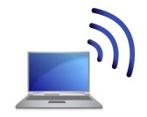
TLS Verification Goal: Secure Channel
Public Key
Infrastructure
client credential
server credential
connect(server,port);
send “GET…”;
data = recv();
send “POST…”;
…
accept(port);
request = recv();
send “<html>…”;
order = recv();
…
client
server
adversary
Security Goal: As long as the adversary does not control
the long-term credentials of the client and server, it cannot
Inject forged data into the stream (authenticity)
Distinguish the data stream from random bytes (confidentiality)
Threat model: Adversary fully controls the network, e.g.
it can redirect traffic to its own server (DNS rebinding)
it can passively read all data (IP monitoring)
it can play an active man-in-the-middle (TCP hijacking)
Notes:
The first research question is: how do we decide whether https:// is secure?
This is not part of the standards.
Especially when interoperating in a dangerous ecosystem.
We want to express clear, strong security guarantees at the HTTPS API (hiding all cryptographic details).

Slide 21

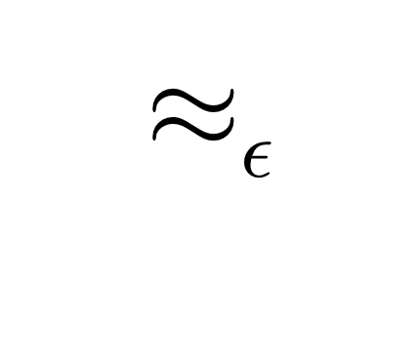
Modelling
Cryptographic
Security
Bytes, Network
lib.fs
Cryptographic Provider
cryptographic assumptions
Main crypto theorem:
concrete TLS & ideal TLS
are computationally
indistinguishable
We then verify that ideal TLS is secure
TLS implementation
TLS ideal implementation
miTLS typed API
miTLS typed API
any program
representing the adversary
Safe, except for a
negligible probability
Safe by typing
(info-theoretically)
Notes:
Except with negligible probability our implementation behaves like an ideal functionality that never sends secrets over the network, instead reading messages from the writer state.
This involves cryptographic reductions, relating the probability of breaking the secure channel to the probability of breaking some core cryptographic algorithms.
We are the first to do this kind of proof at this scale. Moreover, we verify for the ideal functionality that it satisfies a typed interface, which allows to continue verification for applications, without having to worry about the TLS implementation.

Slide 22
Modelling Secure Data Streams
Stream authentication as a distributed state invariant
Data Stream
state shared between
a reader and a writer
TLS Connection
i:id
connection info
reader
writer
duplex
streams when the
connection is secure
Data i #0
Data i #2
Data i #3
data
data
data
Data i #1
Warning i
Error i
Data i #0
data
data
warning
close
Data i #3
Data i #1
reader
i:id
connection info
(how we got here)
writer
writer
reader
Peer TLS Connection
Notes:
To model stream authentication, we relate the state of the sender and the state of the receiver using global ghost variables (aka an idealized functionality with shared logs)
Technically, this is a distributed state invariant.
Message fragments must be received in order.

Slide 23
A key technical problem
Separation and monotonicity
let c1 : Connection = …
let c2 : Connection = …
{ Inv c1 /\ Inv c2 }
TLS.write c1 “message”
{ Inv c1 /\ Inv c2 }
TLS Connection
i:id
connection info
receiver
sender
Data i #0
Data i #2
duplex
streams when the
connection is secure
Data i #3
Data i #1
Warning i
Data i #3
Data i #0
Data i #1
i:id
connection info
(how we got here)
sender
receiver
Peer TLS Connection
Notes:
To model stream authentication, we relate the state of the sender and the state of the receiver.
Message fragments must be received in order.
Technically, this is a distributed state invariant.

Slide 24
A key technical problem
Separation and monotonicity
let c1 : Connection = …
let c2 : Connection = …
{ Inv c1 * Inv c2 }
TLS.write c1 “message”
{ Inv c1 * Inv c2 }
TLS Connection
i:id
connection info
receiver
sender
Data i #0
Data i #2
duplex
streams when the
connection is secure
Data i #3
Data i #1
Warning i
Data i #3
Data i #0
Data i #1
Would like to use separation
Except, their states are not separate!
The log is written by the sender
And read by the receiver
i:id
connection info
(how we got here)
sender
receiver
Peer TLS Connection
Notes:
To model stream authentication, we relate the state of the sender and the state of the receiver.
Message fragments must be received in order.
Technically, this is a distributed state invariant.

Slide 25
A key technical problem
Separation and monotonicity
let c1 : Connection = …
let c2 : Connection = …
{ Inv c1 * Inv c2 }
TLS.write c1 “message”
{ Inv c1 * Inv c2 }
let c1:Connection rgn1 = …
let c2:Connection rgn2 = …
{ Inv c1 /\ Inv c2 }
TLS.write c1 “message”
{ Inv c1 /\ Inv c2 }
Each connection owns a distinct region of memory
TLS Connection
i:id
connection info
receiver
sender
Data i #0
Data i #2
Only rely on
monotone
properties
across
regions
Data i #3
Data i #1
Warning i
Data i #3
Data i #0
Monotone properties are stable
with respect to arbitrary modifications
in another region
Data i #1
i:id
connection info
(how we got here)
sender
receiver
Recalling a Witness: POPL 2018
Peer TLS Connection
Notes:
To model stream authentication, we relate the state of the sender and the state of the receiver.
Message fragments must be received in order.
Technically, this is a distributed state invariant.

Slide 26
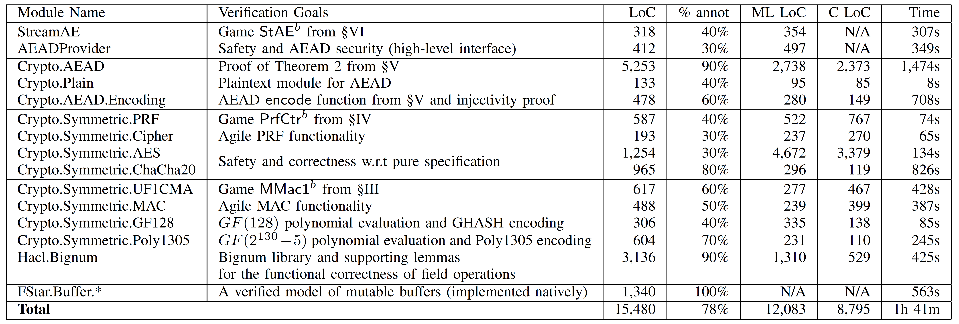
Authenticated Encryption with Additional Data (AEAD)
Crypto algorithms & constructions
~15K lines of code and proofs in F*
But, also performance critical
So, written in a low-level style that compiles to C without a GC
IEEE Security and Privacy 2017

Slide 27
A word about QUIC
HTTPS
X.509
ASN.1
TLS
***
RSA
SHA
ECDH
4Q
Crypto Algorithms
Network buffers
Notes:
Overview of the HTTPS ecosystem, focusing on prior results on TLS.
A few words on X.509, HTTPS, and crypto algorithms.

Slide 28
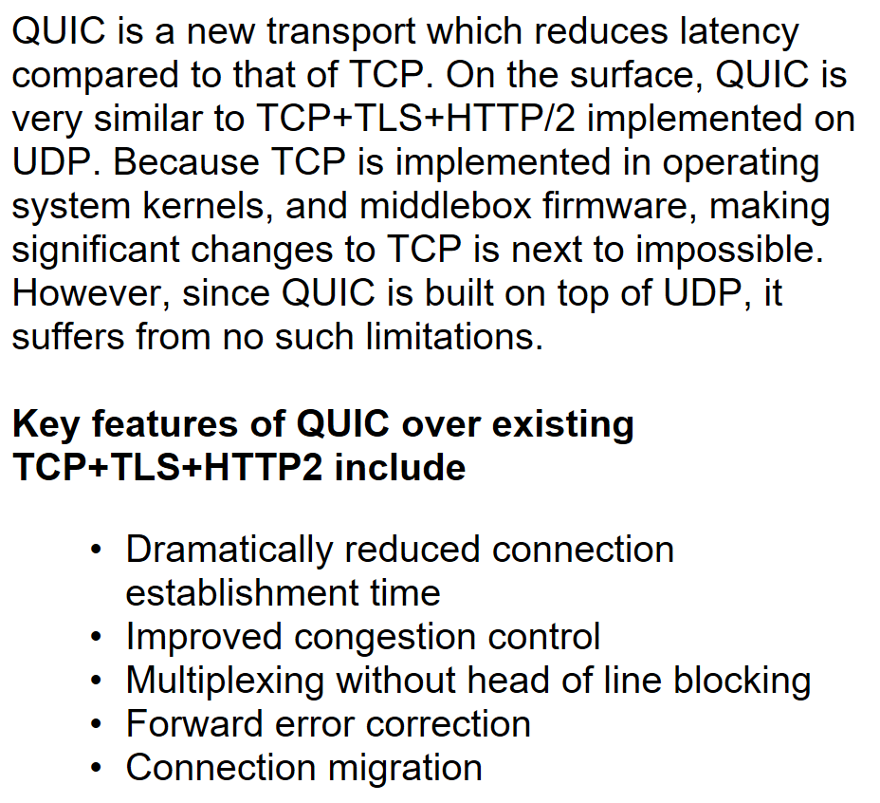
Quick UDP Internet Connections
Google’s “full stack” redesign
Now on standards track, towards fast adoption
  IETF charter from November, active WG
  Security required, but not the focus.
Embeds TLS 1.3 handshake and crypto

Slide 29
Saving roundtrips for new connections (2)
TLS over TCP
Client
Server
Client
Server
Client
Server
Client
Server
Syn
Syn
Syn
0
Ack
0
0
0
Hello
Hello
Hello
Hello
Hello
Hello, Finished
Hello, Finished
0.5
Hello, Finished
0.5
1
1
Finished
Finished
1
Finished
1
Finished
Finished
2
2
2
2
TLS 1.2
TLS 1.3
TLS 1.3
TLS + QUIC
Two roundtrips before sending
application data
One roundtrip before sending
application data
Zero roundtrip before sending
application data
Cuts an extra roundtrip, enables more multiplexing
Notes:
Skip this slide?

Slide 30
Early Deployments
Google deployed earlier QUIC over UDP between their clients & servers since 2013!
  Large-scale BoringSSL client deployment
  of TLS 1.3#18 in Chrome 56 (Feb’17)
  for desktop and Android. Setback due to non-compliant middleboxes dropping connections
  (Chromebooks in schools?)
Mozilla
Released TLS 1.3#18, working on #20,
but not enabled by default in Firefox
OpenSSL
Next release 1.1.1 supporting TLS 1.3
draft 20 (April’17, late)
Facebook deployed Zero, a variant of QUIC over TCP, since 2016
Implementing their own TLS 1.3. Concerned about 0RTT replayability (Bloom filters)
Amazon using their own s2n
(100% since Feb’17), extending it to TLS 1.3,
also concerned about 0RTT security.
CloudFlare deployed TLS 1.3 on edge servers (Mar’17)
Metric (% of connections) | 50% | 75%
Connection Establishment | -34% | -41%
Total request time (new connection required) | -8% | -11%
Notes:
See https://github.com/tlswg/tls13-spec/wiki/Implementations for a comprehensive list of mainstream and experimental implementations, as well as test servers
Google (BoringSSL)
TLS 1.3 (Draft-18) enabled by default in Chrome 56 for desktop & Android (Jan’17)
Rolled back after issues with BlueCoat software proxies, among other middleboxes (Feb’17, open Chromium bug)
Can be enabled through chrome:flags in Chrome >= 57
Facebook (Zero)
Deployed Zero, a tweaked variant of QUIC running over TCP featuring 0-RTT, in 2016
Uses Bloom filter to implement a replay cache
Currently writing their own TLS 1.3 implementation to replace Zero
OpenSSL
Promised to deliver a version with OpenSSL support by April 5. Still unreleased
The upcoming as yet unreleased 1.1.1 version will add support for TLS 1.3
Mozilla
NSS 3.30 implements draft-18; draft-20 implementation under development
Available but disabled by default on the Release channel. Can be enabled from about:config
Cloudflare
TLS 1.3 support added to edge servers in Mar’17. Must be enabled explicitly from the dashboard
No support nor plan to support it for communication between edge and origin
Amazon (s2n)
Released s2n, its own implementation of TLS, as open source (Apache license) in 2015
Working on adding support for 1.3, but wary of replayability and loss of security of 0-RTT data
ARM (mbed TLS, ex PolarSSL)
Acquired PolarSSL in 2014. Now distributed as mbed TLS under Apache license
No public official plans for 1.3, but they are certainly working on it
https://www.youtube.com/watch?v=dMPWwYyGWrg

Slide 31
Building a
High-Assurance
Crypto Library in C
(KreMLin, Hacl*)
HTTPS
X.509
ASN.1
TLS
***
RSA
SHA
ECDH
4Q
Crypto Algorithms
Network buffers

Slide 32
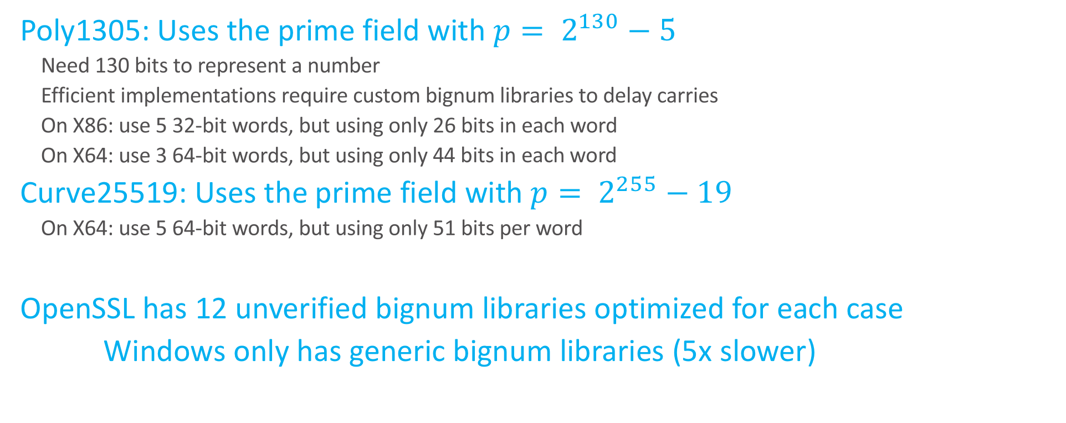
Efficient crypto requires a lot of customizations
Poly1305: Uses the prime field with ${p= 2}^{130}−5$
    Need 130 bits to represent a number
    Efficient implementations require custom bignum libraries to delay carries
    On X86: use 5 32-bit words, but using only 26 bits in each word
    On X64: use 3 64-bit words, but using only 44 bits in each word
Curve25519: Uses the prime field with ${p= 2}^{255}−19$
    On X64: use 5 64-bit words, but using only 51 bits per word
OpenSSL has 12 unverified bignum libraries optimized for each case
Windows only has generic bignum libraries (5x slower)
Notes:
Windows library for Montgomery ladder

Slide 33
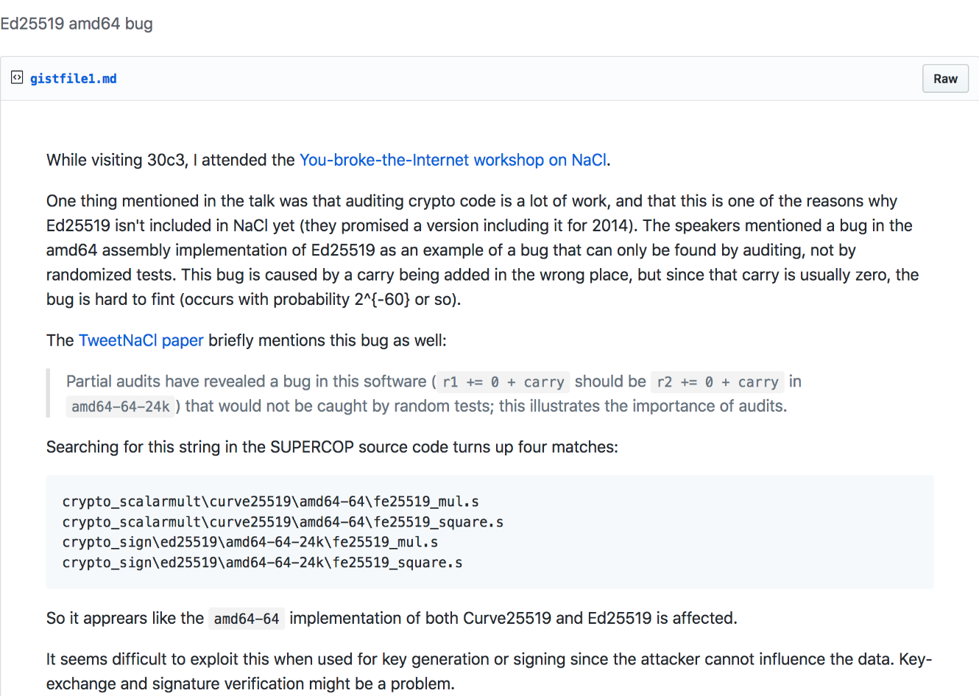
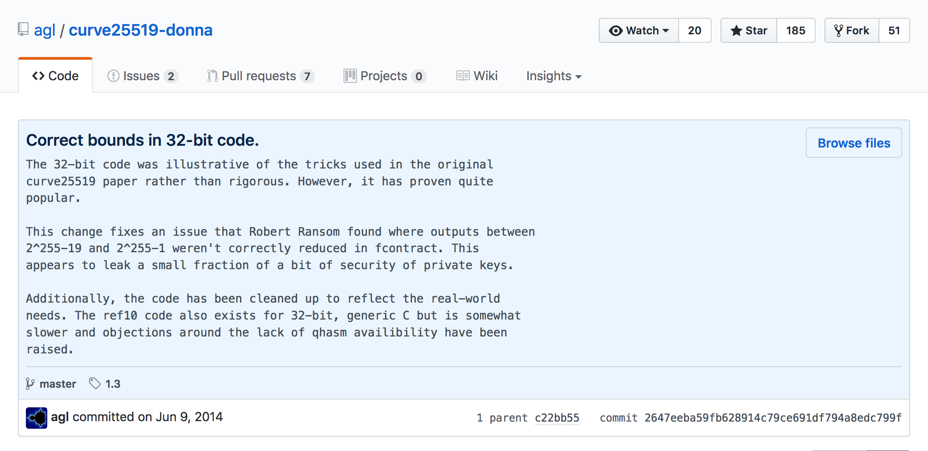
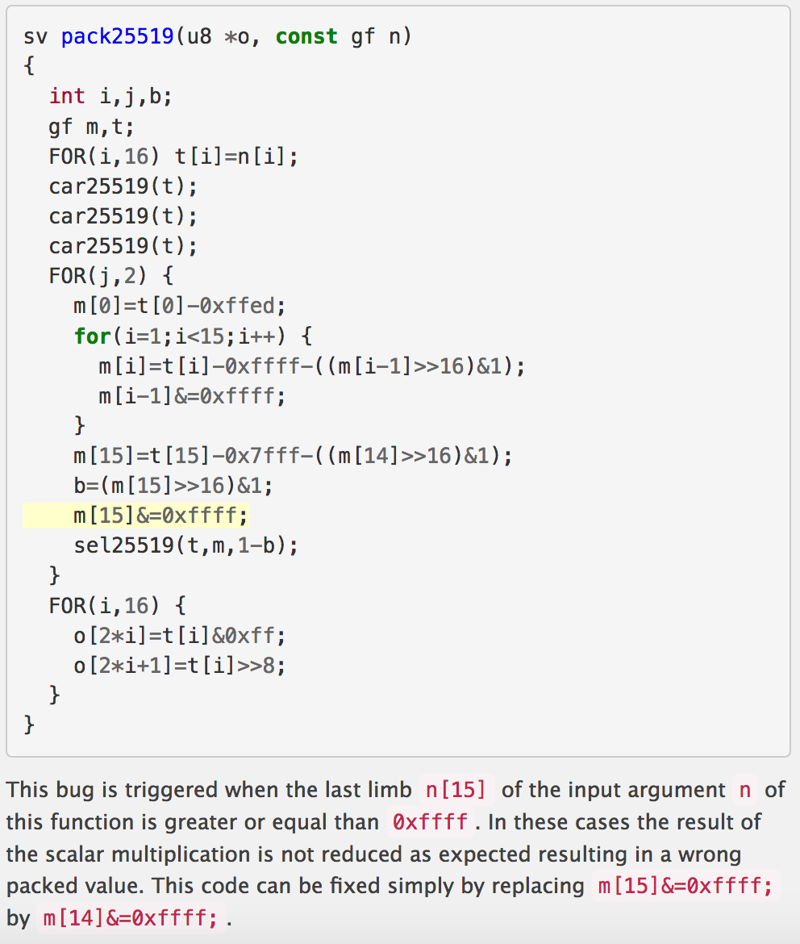
Many bugs in Curve25519 implementations
(C and assembly)
NaCl (asm)
Curve25519-donna
TweetNaCl

Slide 34
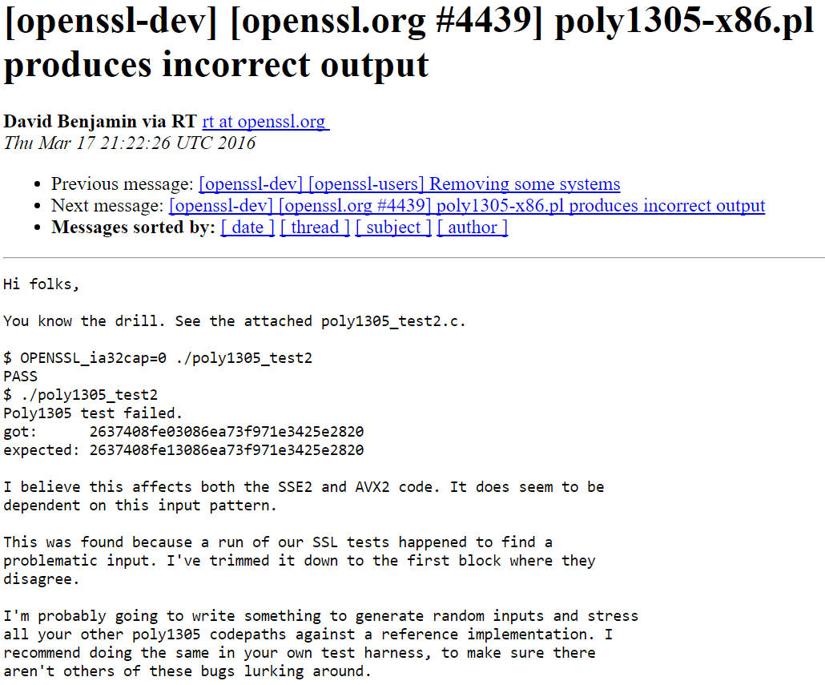
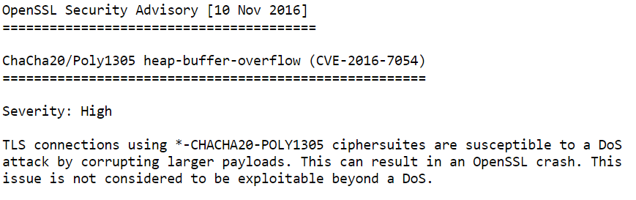
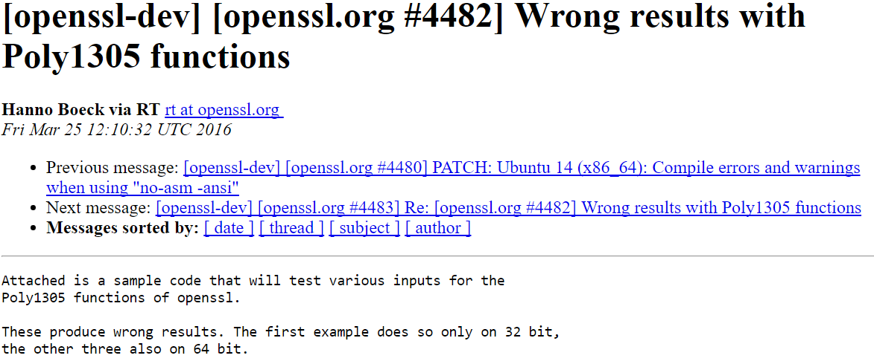
3 Bugs in OpenSSL implementation of Poly1305 last year
Low*
“These produce wrong results. The first example does so only on 32 bit,
the other three also on 64 bit.”
“I believe this affects both the SSE2 and AVX2 code. It does seem to be
dependent on this input pattern.”
“I'm probably going to write something to generate random inputs and stress
all your other poly1305 code paths against a reference implementation.”

Slide 35
OpenSSL SHA
Meta-programming assembly implementations of SHA with perl

Slide 36
Our general methodology
High-level proofs for low-level code
Program libraries at a high-level of genericity
Verify them once and for all
Cryptographically secure
Functionally correct
Side-channel resistant
Extract multiple efficient low-level implementations

Slide 37
Programming and verification tools of Everest
Vale: A special purpose
language and tool for
verified assembly language
F*: A general purpose
programming language
and verification tool
Translated to F* for proof
Vale
Assembly
Emitted by F* for execution
kreMLin
Compiler from (a subset of) F* to C
C
Clang, gcc,
Msvc, …
gcc,
masm, …
.dll/.so
Notes:
Long-term research effort, not specific to communications security.
By necessity we will improve our tools and their usability.
Automation is key (Z3)

Slide 38
Low*, a subset of F* for verified C-style programming
And to support compilation to C, in nearly 1-1 correspondence, for auditability of our generated code
Designed to allow manipulating a C-like view of memory
Low*
C
COMPILED
Erased
specification
Stack allocation
Pointer arithmetic
ICFP 2017

Slide 39
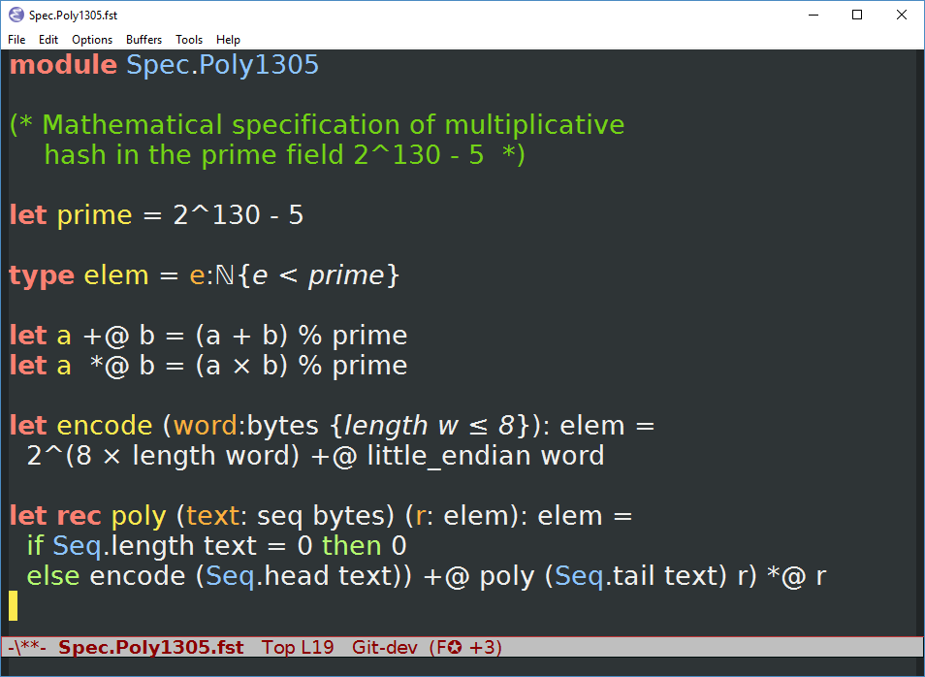
Finally, trust a simple top-level mathematical spec
  Functional correctness
  Side-channel resistance
  Cryptographic security

Slide 44
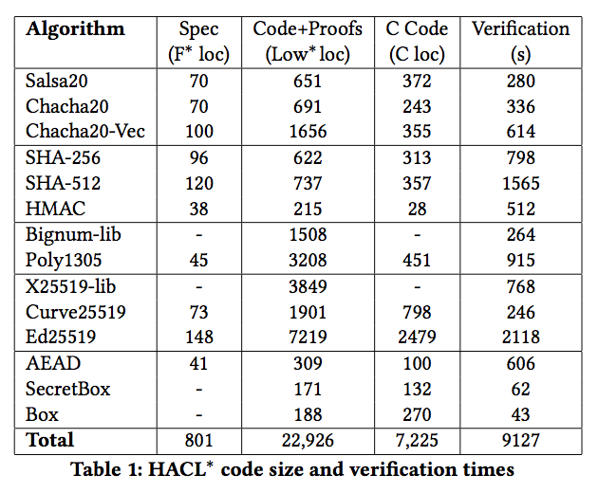
Performance: High Assurance Crypto Library in Low*
(aka HACL*)
Several complete TLS ciphersuites
Verification can scale up!
Low*
Verification enables using 64x64 bit multiplications, without fear of getting it wrong
cycles/ECDH
With performance as good as or better than hand-written C
But, still slower than best
assembly implementations

Slide 47
OpenSSL SHA and Vale SHA
procedure Body_00_15(inline i:int, …
inout operand a:uint32, …, inout operand h:uint32)
…
{
inline if (i < 16) {
inline if (i == 15) {
STR(t4, sp, const(17*4), Public);
}
EORShift(t0, e, e, RORShift(Sigma1(1) - Sigma1(0)));
ADDWrap(a, a, t2);
EORShift(t0, t0, e, RORShift(Sigma1(2) - Sigma1(0)));
REV(t1, t1);
}
…
}
procedure Body_00_15_Unroll(inline i:int, …
inout operand a:uint32, …, inout operand h:uint32) … { …
inline if (i < 16) {
… Body_00_15(i, …a, b, c, d, e, f, g, h) ….
… Body_00_15_Unroll(i + 1, …, h, a, b, c, d, e, f, g) …
} …
}

Slide 48
Vale: extensible, assembly language verification
machine model (F*)
Vale code
instructions
Trusted
Computing
Base
machine interface
type reg = r0 | r1 | ...
type ins =
Mov(dst:reg, src:reg)
| Add(dst:reg, src:reg)
| Neg(dst:reg)
…
procedure mov(…)
requires …
ensures …
{ … }
procedure add(…)
…
Vale
semantics
crypto spec
code
proof
eval(Mov(dst, src), …) = …
eval(Add(dst, src), …) = …
eval(Neg(dst), …) = …
…
mem[eax] ==
SHA(mem[ebx])
[Mov(r1, r0),
Add(r1, r0),
Add(r1, r1)]
lemma_mov(…);
lemma_add(…);
lemma_add(…);
program
procedure quadruple(…)
requires 0 <= r0 < 2³⁰;
ensures r1 == r0 * 4;
{
mov(r1, r0);
add(r1, r0);
add(r1, r1);
}
code generation
print(Mov(dst, src), …) =
“mov “ + (…dst) + (…src)
print(Add(dst, src), …) = …
…
USENIX Security 2017
Notes:
TODO: Show the spec
TODO: finesse the Mindy point later

Slide 49
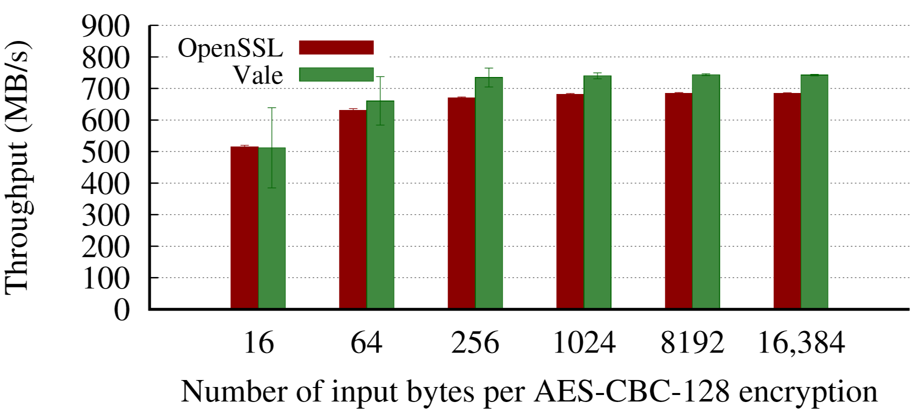
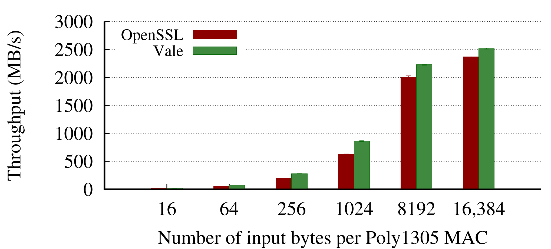
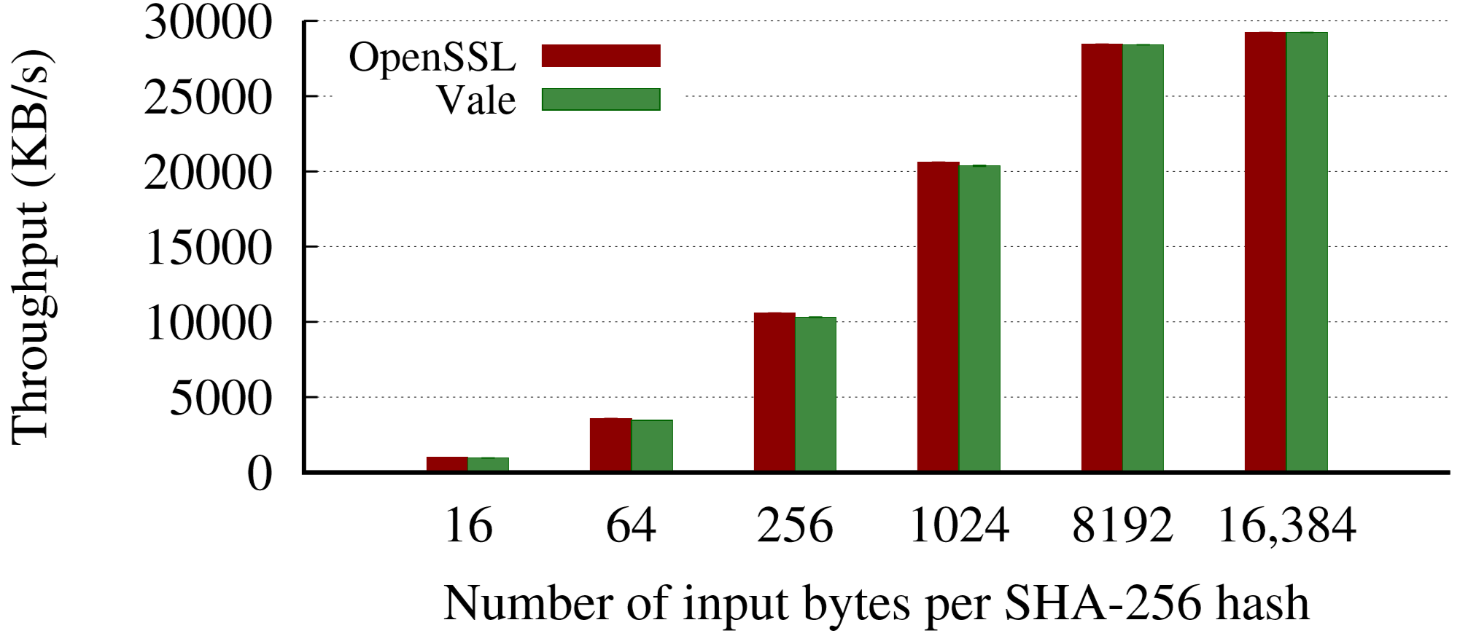
Crypto performance: OpenSSL vs. Vale
AES: OpenSSL with SIMD, AES-NI
Poly1305 and SHA-256: OpenSSL non-SIMD assembly language
  Same assembly code for OpenSSL, Vale

Slide 50
Reconciling HACL* and Vale: EverCrypt
Essentially, a replacement for OpenSSL’s libcrypto library
  EverCrypt is a new component from Project Everest that offers a unified, verified cryptographic library. Clients of EverCrypt enjoy:
  - functionally-correct, memory-safe, side-channel resistant implementations of modern cryptographic algorithms,
  - multiple implementations, coming either from Vale, HACL*, or system libraries (OpenSSL, BCrypt)
  - a unified set of specifications that all implementations verify against
  - automatic CPU feature detection to ensure the best implementation is selected at run-time.
  Careful abstraction over state ensures that clients do not need to be aware of the particular choice of implementation, and can reason against the specifications, abstractly. We demonstrate seamlessly switching between Vale and HACL* for the SHA256 algorithm.

Slide 51
A word about the
KreMLin tool
HTTPS
X.509
ASN.1
TLS
***
RSA
SHA
ECDH
4Q
Crypto Algorithms
Network buffers

Slide 53
WebAssembly: a portable, binary format for the web
Shipped in all major browsers (including Edge)
WASM delivers portability and performance
LLVM backend (“emscripten”)
Opportunity:
Desktop applications are running on a web framework like Electron (e.g. Skype, Signal, VS Code, Atom, WhatsApp)
Framework support for cryptography is lacking (WebCrypto on the web, node.js crypto on the desktop)
A WASM backend for KreMLin:
Auditable and delivers competitive performance
An alternative, faster, less trustworthy backend: Low* -> C (via KreMLin) -> WASM (via LLVM)
HACL* for the web: enables instant access to the latest cryptographic primitives on both Desktop & Web
Looking forward:
Use the WASM backend of KreMLin for verified, fast implementation of messaging protocols
Reach out to new clients internally

Slide 58

Deploying a
High-Assurance
Crypto Library
HTTPS
X.509
ASN.1
TLS
***
RSA
SHA
ECDH
4Q
Crypto Algorithms
Network buffers

Slide 59

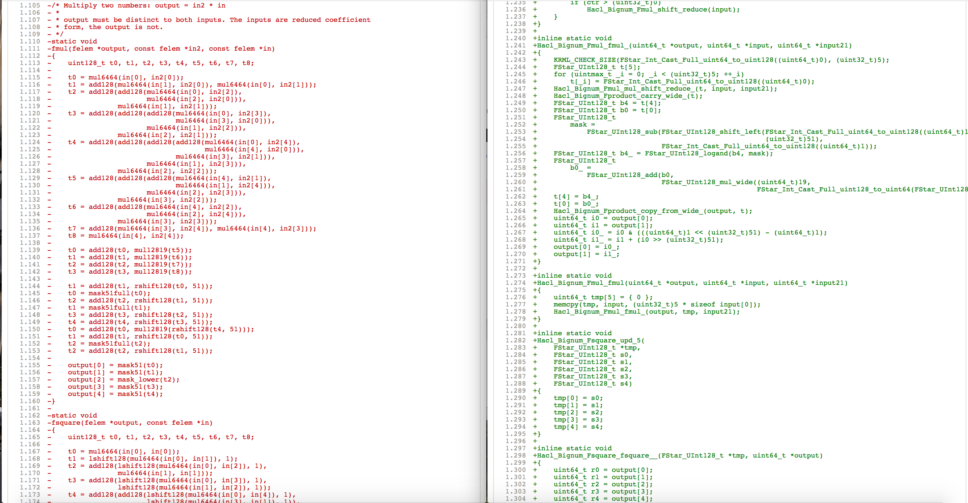

From a futuristic verified
software methodology
To polished code used in
a production environment
From Ben Beurdouche’s slide deck

Slide 60
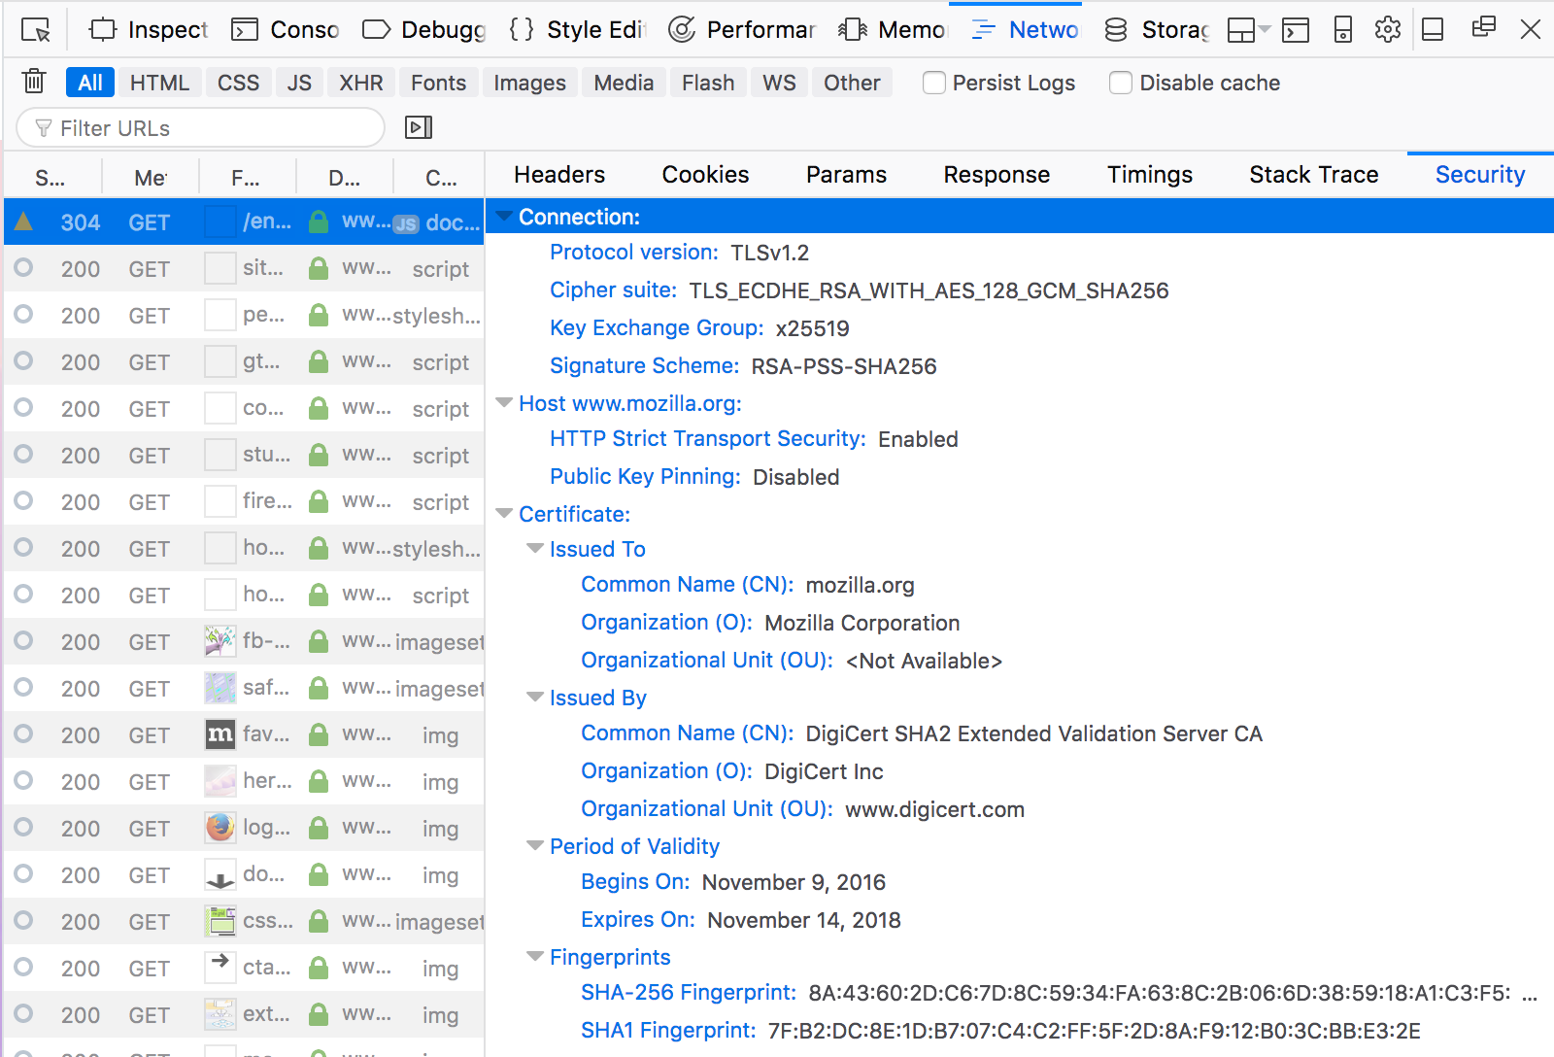
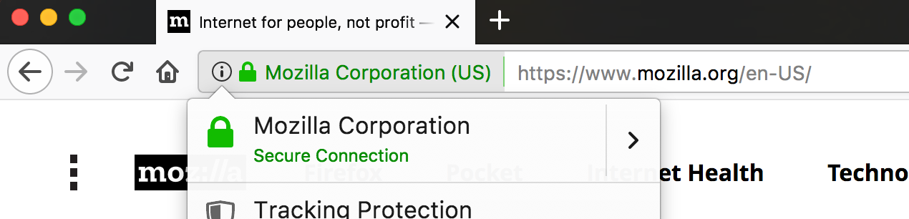

HACL* in Mozilla Firefox
From Ben Beurdouche’s slide deck

Slide 61

Networking Security Services (NSS) library
Multi product security library
  Security Library for Firefox in C/C++
  Joint effort from Mozilla, RedHat…
  Used in RHEL, Fedora, BSDs…
Large number of primitives
  Implements multiple cryptographic primitives
  Recent and legacy primitives for interoperability
Large number of protocols
  Implements TLS, DTLS, QUIC… (HTTPS, WebRTC…)
  PKCS #5, #7, #11, #12, S/MIME, X.509
  Huge amount of knowledge has been accumulated here…
  (EKR is the TLS spec. author)
From Ben Beurdouche’s slide deck

Slide 62
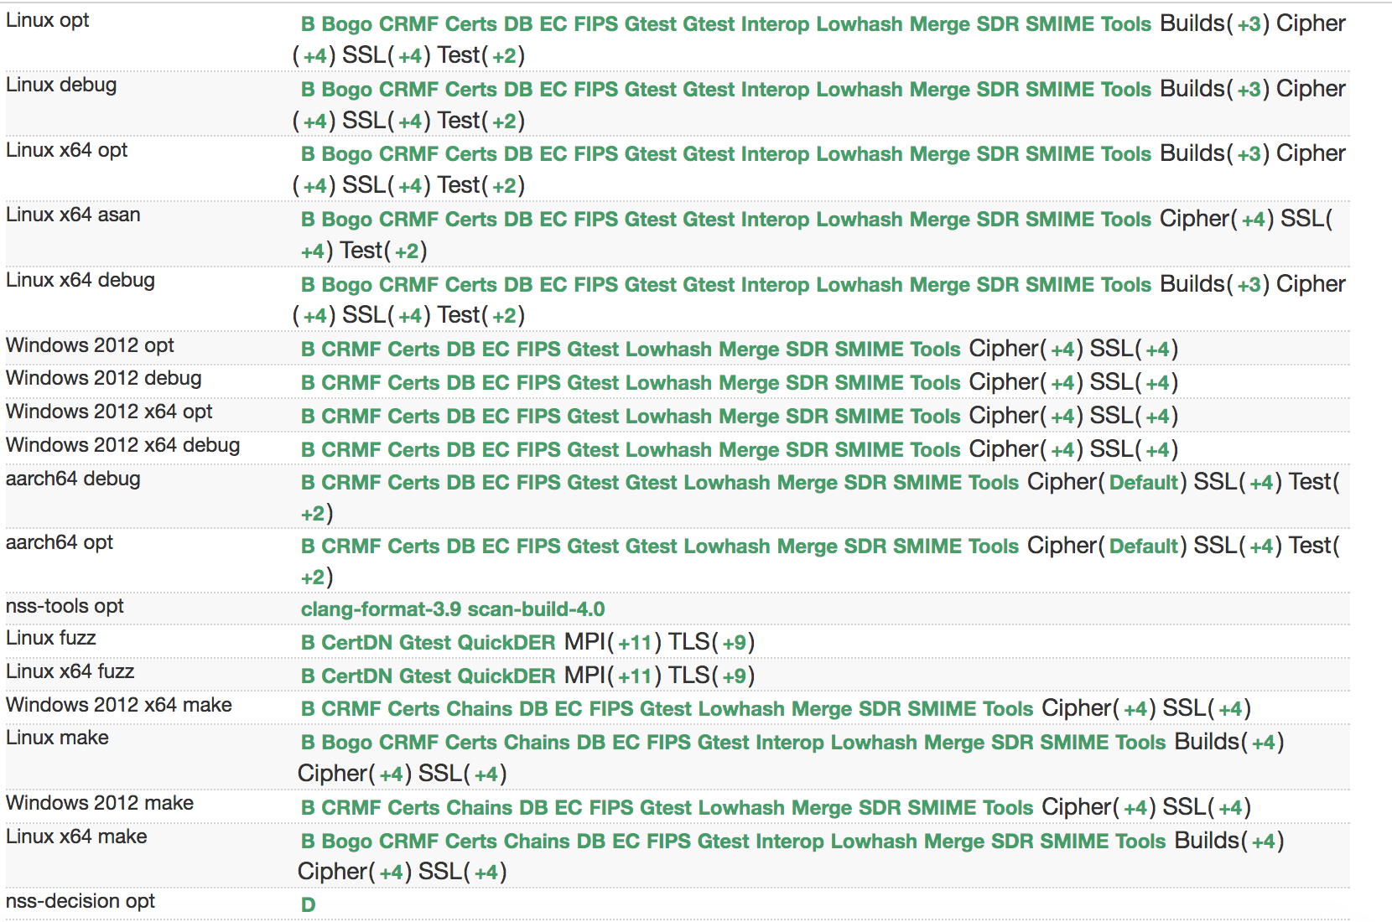
HaCl* - Formally verified Curve25519 in NSS
Iterative development process
  Generate the code for a primitive
  What does not look good in the generated C code ?
  Improve the extraction process to make the code better
    Remove more computationally irrelevant code
    Remove as much intermediate variable as possible…
    Make the code look better
    Improve performance
  Never ever ever edit the verified code manually !!
Continuous integration
  Make sure nobody edit the verified code when making commits
  Make sure Mozilla has sovereignty and can run the verification and the code generation in the CI independently from us
From Ben Beurdouche’s slide deck

Slide 63
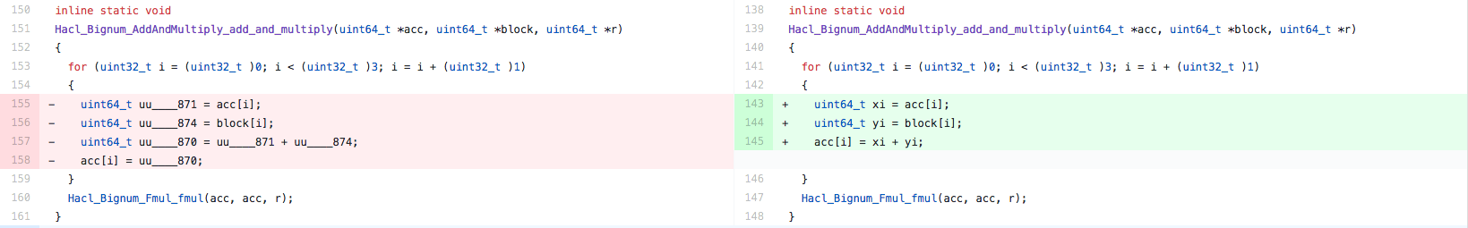
HaCl* - Formally verified Curve25519 in NSS
The process is disruptive, implying lots of questions !
  Huh ! This doesn’t look as pretty as handwritten code !
    Yeah sure but it has a correctness proof…
And, improvements in performance
  +20% scalar-multiplications per sec. (19k/sec)
  To our knowledge, the fastest C implementation
Next batch of primitives on its way…
  Chacha20 (Firefox 58 ?)
  Poly 1305 + SHA2 + HMAC + HKDF (Firefox59 ?)
Lot of improvements remain on the generated code side
  We will make continuous improvements to the code
From Ben Beurdouche’s slide deck

Slide 64
Deploying a
High-Assurance
Crypto Library
HTTPS
X.509
ASN.1
TLS
***
RSA
SHA
ECDH
4Q
Crypto Algorithms
Network buffers

Slide 68
Open
Questions
Notes:
A brief overview of our method.

Slide 69
Research questions
Game-based cryptography on efficient implementations
Proofs of side-channel resistance
  Current approach based on parametricity for constant time crypto
  But, we need more subtle techniques higher up the protocol stack
  Relational reasoning in F* (CPP 2018)
Automated, Expressive, Controllable verification tools
  Balancing SMT + Tactic-based interactive proofs in F* + Lean + Z3
Certification
  Proving our tools trustworthy, independently checkable

Slide 70
Developer acceptance and maintenance
Why will people risk deploying unfamiliar verified code?
Why choose Everest over OpenSSL?
Who will patch Everest overnight?
Who will maintain Everest 10 years from now?
How do we keep deployed C/C++ code
from diverging from high-level verified code?
Notes:
Even certification isn’t enough. Why will people really trust us?
No-one ever gets blamed for deploying OpenSSL – as long as patches are regularly applied.

Slide 71
Developer acceptance approach
Open-source standard-compliant transparent development
    Early reference implementation of TLS 1.3
    IETF endorsement + interop and performance testing
Compile to clean readable commented C++ code
    Allows developers to
      Ignore verification machinery, if desired
      Apply code reviews, auditing, or any other reasoning approaches
Drop-in replacements in popular software (API compatibility)
    Also: interop & security testing tools for specialists (flexTLS)
    Also: lightweight deployment with minimal TCB (SGX)
Resilience to ongoing CVEs in other implementations
Time…

Slide 72
Everest 2016—2021:
Verified Components
for the HTTPS
Ecosystem
Services & Applications
Edge
cURL
WebKit
Skype
IIS
Apache
Nginx
Clients
Servers
HTTPS
Certification Authority
X.509
ASN.1
Strong verified security
Widespread deployment
Trustworthy, usable tools
Growing expertise in
high-assurance software
development
TLS
***
RSA
SHA
ECDH
AES
Crypto Algorithms
Network buffers
Untrusted network (TCP, UDP, …)
Notes:
Fully-verified standards-compliant replacement
- We will prove cryptographic security, not just eliminate bugs.
- As a result, we rule out both past attacks, and attacks we haven’t even thought of yet
Many academically successful verification projects. Few deployments.

Slide 73
Maintenance approach
Improve usability of verification tools to the point where outsiders can adapt, improve, recompile our code
Build a thriving open-source community
Buy-in from Microsoft and others? See OpenSSL

